Slide 1
Machine Learning

Slide 2
About This Course
Two-day short course
After this course, you can get:
Familiar with the basic concepts of AI and have self-learning capabilities
Clarify the mapping between problems in your professional scenarios and classic AI tasks
Independently implement an image classification task and complete training using Mindspore
Understand the latest research fields, such as device-cloud collaboration, automated machine learning, unsupervised learning tasks, etc., to clarify the direction for future research

Slide 3

About Mindspore
Huawei Full-Stack AI Solution
AI Applications
HiAI Service
General APIs
Advanced APIs
Pre-integrated Solutions
Application enablement: provides end-to-end services (ModelArts), layered APIs, and pre-integrated solutions.
ModelArts
Application enablement
HiAI Engine
MindSpore
TensorFlow
PyTorch
PaddlePaddle
…
Framework
MindSpore: supports independent and collaborative device-edge-cloud training and inference frameworks.
CANN
(Compute Architecture for Neural Networks)
CANN: a chip operator library and highly automated operator development tool.
Chip enablement
Ascend
Ascend: a series of AI IPs and chips based on a unified, scalable architecture.
Ascend-Nano
Ascend-Tiny
Ascend-Lite
Ascend-Mini
Ascend-Max
IP & chips
Consumer devices
Public cloud
Private cloud
Edge computing
Industrial devices
All scenarios

Slide 4
About This Course
Timetable for this morning
9:00 - 10:30
Machine learning: regression problems, gradient descent, classification problems, overfitting
Practical exercise: realization of solving linear regression problems based on gradient descent
Deep neural networks: basic concepts, feedforward networks, activation functions
10:45 - 12:15
Deep neural network: back propagation, the concept of generalization
Training deep learning models: challenges, loss function and regularization, optimizer and learning rate
Practical exercise: display of the process of solving function extreme points with different optimizers

Slide 5
Basics of Machine Learning

Slide 6
About This Course
This part intends to explain:
Basic knowledge of machine learning
Regression, gradient descent, classification, as well as overfitting and underfitting

Slide 7
Contents
Regression
Gradient Descent
Classification
Overfitting and Underfitting

Slide 8
Definition
Regression algorithms usually use a series of properties to predict values, and the predicted values are continuous.
Predict the price of a house based on house characteristics, such as the area and number of bedrooms.
Predict temperature based on satellite cloud images and temperature changes in the past week.
Common types:
Linear regression
Polynomial regression
Logistic regression

Slide 9
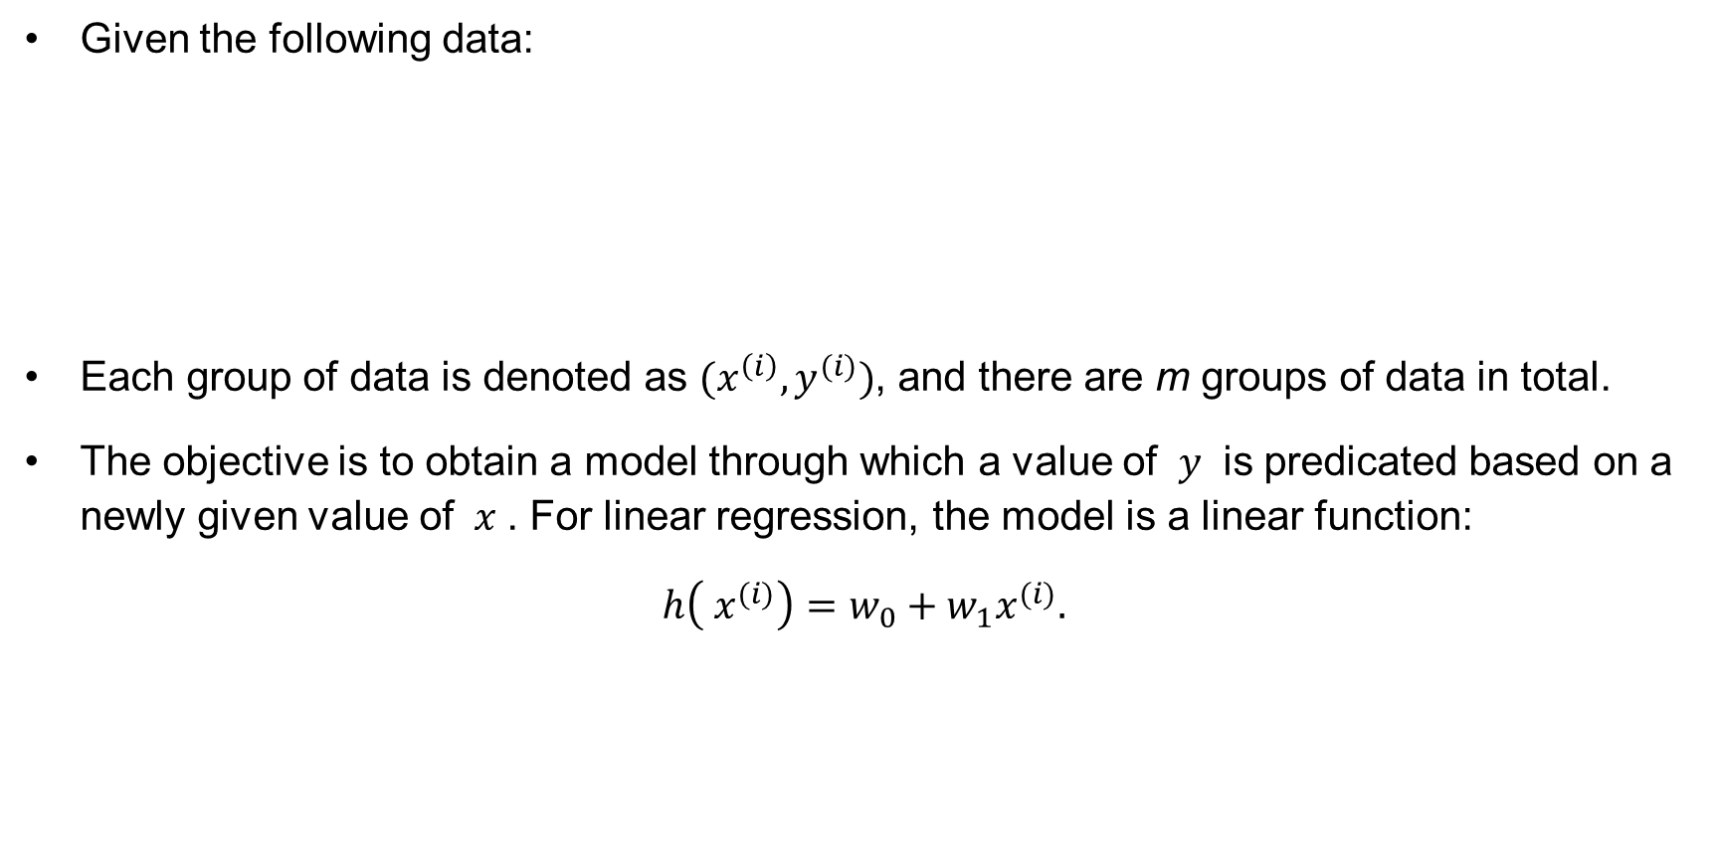
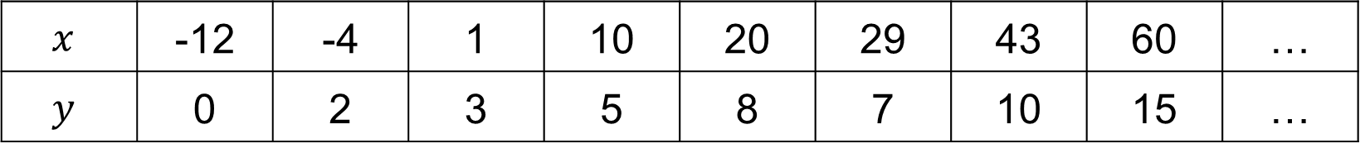
Linear Regression
Given the following data:
Each group of data is denoted as $(x^{\left(i\right)},y^{(i)})$, and there are m groups of data in total.
The objective is to obtain a model through which a value of $y$ is predicated based on a newly given value of $x$. For linear regression, the model is a linear function:
$h\left( x^{(i)}\right)=w_{0}+w_{1}x^{(i)}.$
$$x$$ | -12 | -4 | 1 | 10 | 20 | 29 | 43 | 60 | …
$$y$$ | 0 | 2 | 3 | 5 | 8 | 7 | 10 | 15 | …

Slide 10
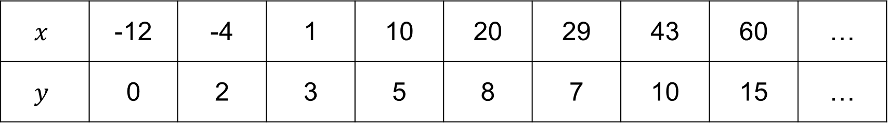
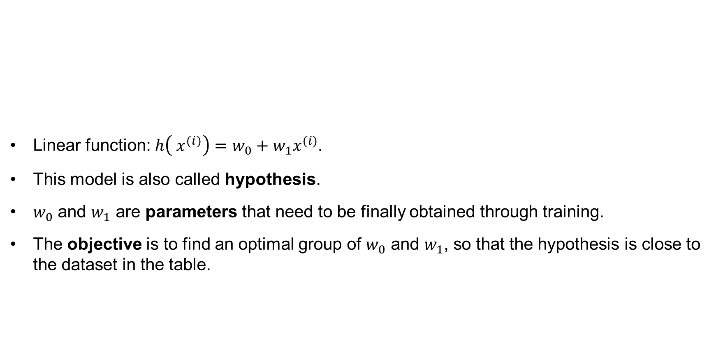
Linear Regression
Linear function: $h\left( x^{(i)}\right)=w_{0}+w_{1}x^{(i)}.$
This model is also called hypothesis.
$w_{0}$ and $w_{1}$ are parameters that need to be finally obtained through training.
The objective is to find an optimal group of $w_{0}$ and $w_{1}$, so that the hypothesis is close to the dataset in the table.
$$x$$ | -12 | -4 | 1 | 10 | 20 | 29 | 43 | 60 | …
$$y$$ | 0 | 2 | 3 | 5 | 8 | 7 | 10 | 15 | …

Slide 11
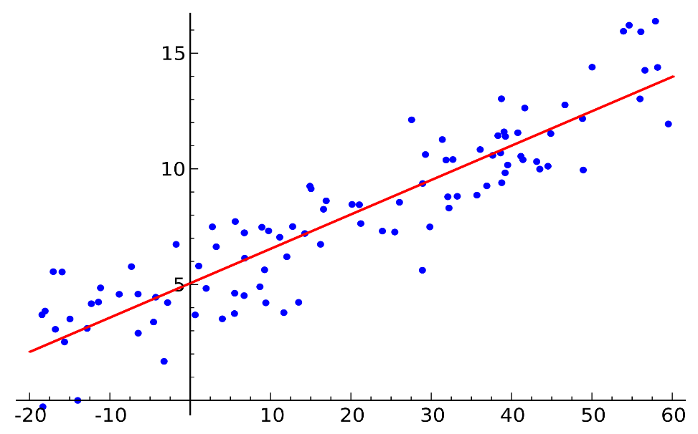
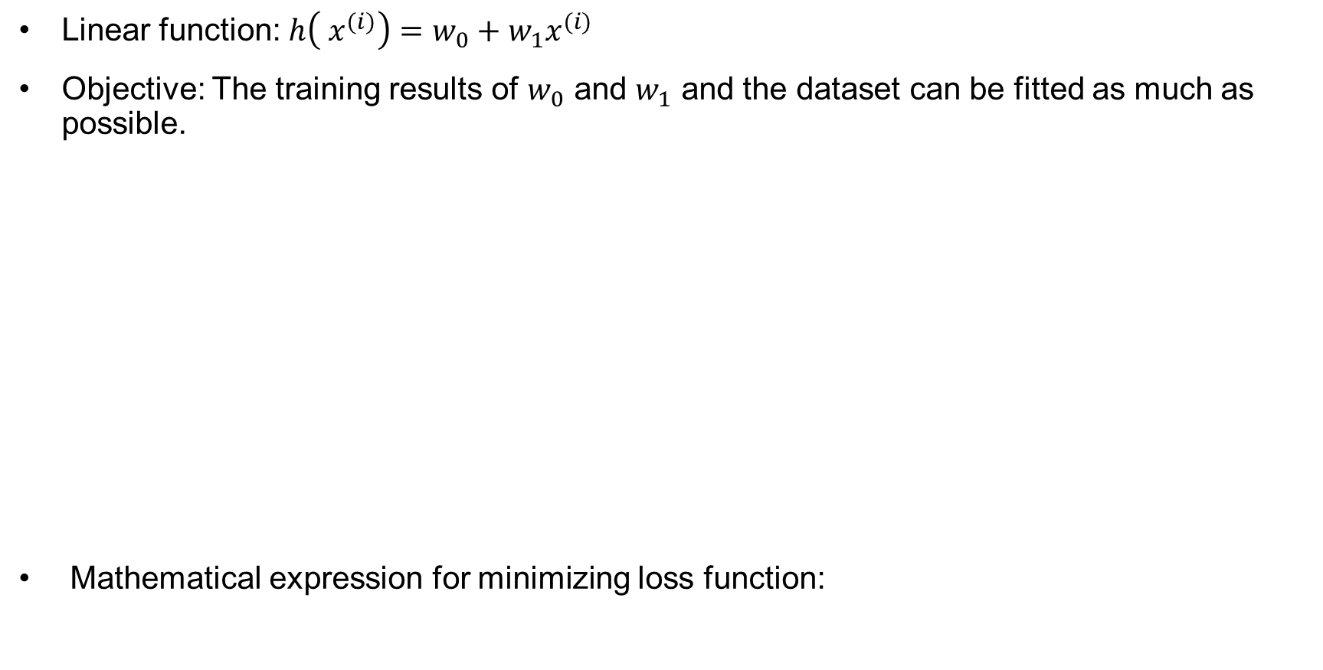
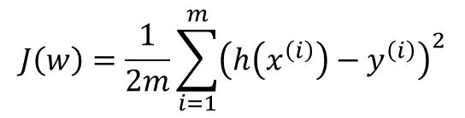
Linear Regression
Linear function: $h\left( x^{(i)}\right)=w_{0}+w_{1}x^{(i)}$
Objective: The training results of $w_{0}$ and $w_{1}$ and the dataset can be fitted as much as possible.
Mathematical expression for minimizing loss function:
Figure 1 Linear regression model
$$J\left(w\right)=\frac{1}{2m}\sum_{i=1}^{m}{{\left(h\left(x^{\left(i\right)}\right)−y^{\left(i\right)}\right)}^{2}}$$

Slide 12
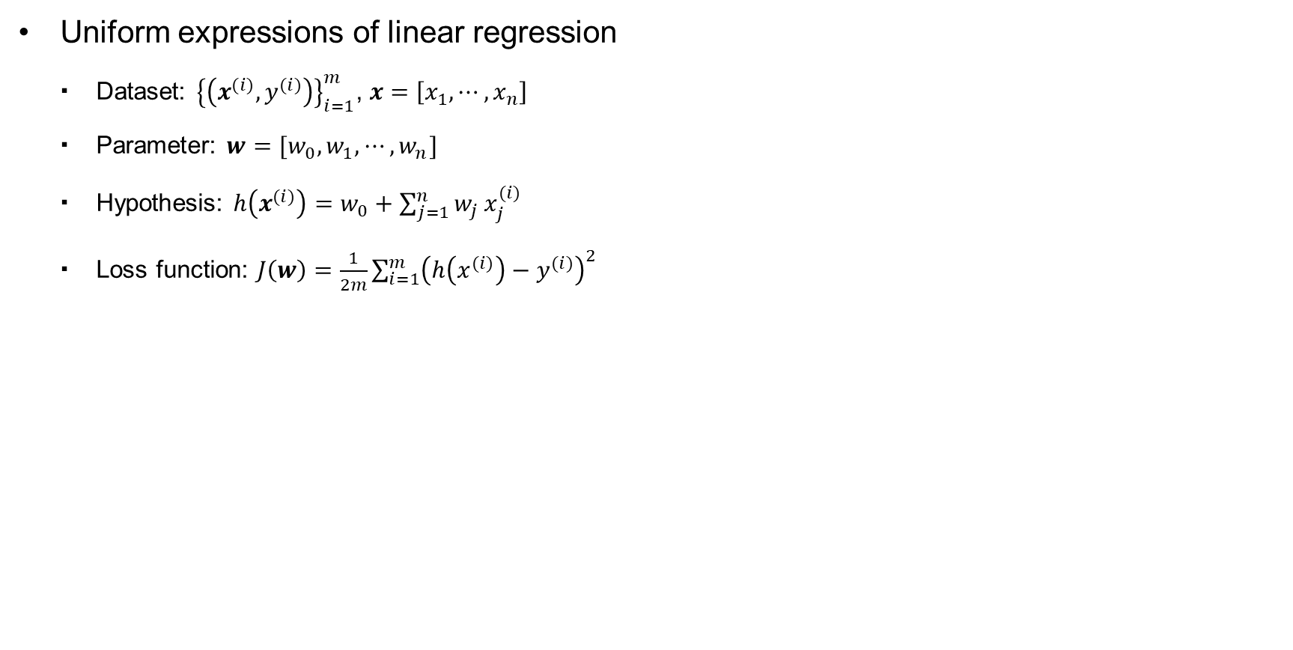
Linear Regression Expression
Uniform expressions of linear regression
Dataset: ${\left\{\left(x^{(i)}, y^{(i)}\right)\right\}}_{i=1}^{m}$, $x=\left[x_{1},⋯,x_{n}\right]$
Parameter: $w=[w_{0},w_{1},⋯,w_{n}]$
Hypothesis: $h\left(x^{(i)}\right)=w_{0}+\sum_{j=1}^{n}{w_{j}}x_{j}^{(i)}$
Loss function: $J\left(w\right)=\frac{1}{2m}\sum_{i=1}^{m}{{\left(h\left(x^{(i)}\right)−y^{(i)}\right)}^{2}}$

Slide 13
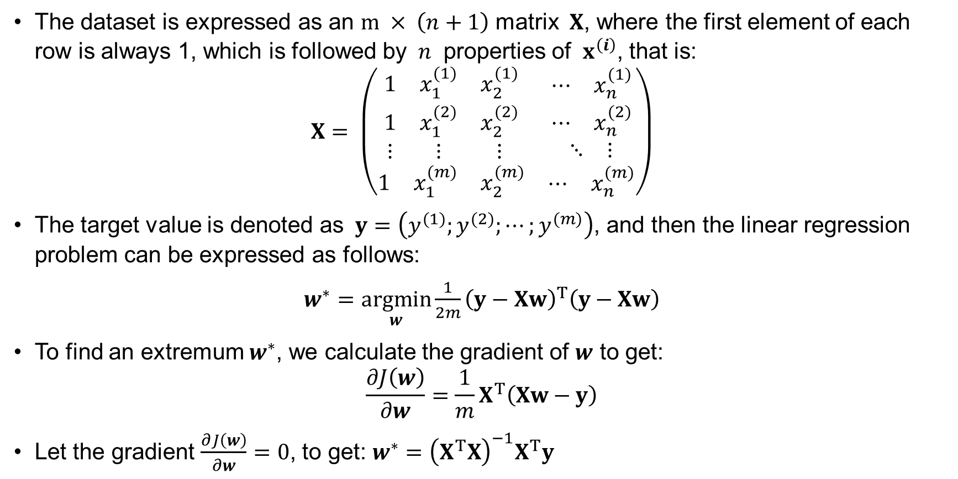
Linear Regression Solution
The dataset is expressed as an $m × \left(n+1\right)$ matrix $X$, where the first element of each row is always 1, which is followed by $n$ properties of ${ x}^{\left(i\right)}$, that is:
$X= \left(\begin{matrix}\begin{matrix}1 & x_{1}^{(1)} & x_{2}^{(1)} \\ 1 & x_{1}^{(2)} & x_{2}^{(2)} \\ ⋮ & ⋮ & ⋮\end{matrix} & \begin{matrix}\begin{matrix}⋯ & x_{n}^{(1)}\end{matrix} \\ \begin{matrix}⋯ & x_{n}^{(2)}\end{matrix} \\ \begin{matrix}⋱ & ⋮\end{matrix}\end{matrix} \\ \begin{matrix}1 & x_{1}^{(m)} & x_{2}^{(m)}\end{matrix} & \begin{matrix}⋯ & x_{n}^{(m)}\end{matrix}\end{matrix}\right)$
The target value is denoted as $y=\left(y^{(1)};y^{(2)};⋯;y^{(m)}\right)$, and then the linear regression problem can be expressed as follows:
$w^{∗}=\underset{w}{argmin}{\frac{1}{2m}{\left(y−Xw\right)}^{T}\left(y−Xw\right)}$
To find an extremum $w^{∗}$, we calculate the gradient of $w$ to get:
$$\frac{∂J\left(w\right)}{∂w}=\frac{1}{m}X^{T}\left(Xw−y\right)$$
Let the gradient $\frac{∂J\left(w\right)}{∂w}=0$, to get: $w^{∗}={\left(X^{T}X\right)}^{−1}X^{T}y$

Slide 14
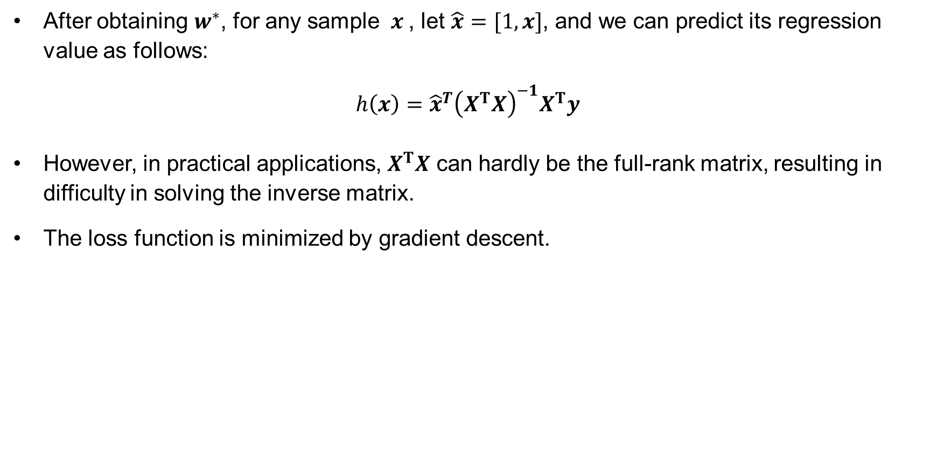
Linear Regression Solution
After obtaining $w^{∗}$, for any sample $x$, let $\hat{x}=[1,x]$, and we can predict its regression value as follows:
$h\left(x\right)={\hat{x}}^{T}{\left(X^{T}X\right)}^{−1}X^{T}y$
However, in practical applications, $X^{T}X$ can hardly be the full-rank matrix, resulting in difficulty in solving the inverse matrix.
The loss function is minimized by gradient descent.

Slide 15
Contents
Regression
Gradient Descent
Classification
Overfitting and Underfitting

Slide 16
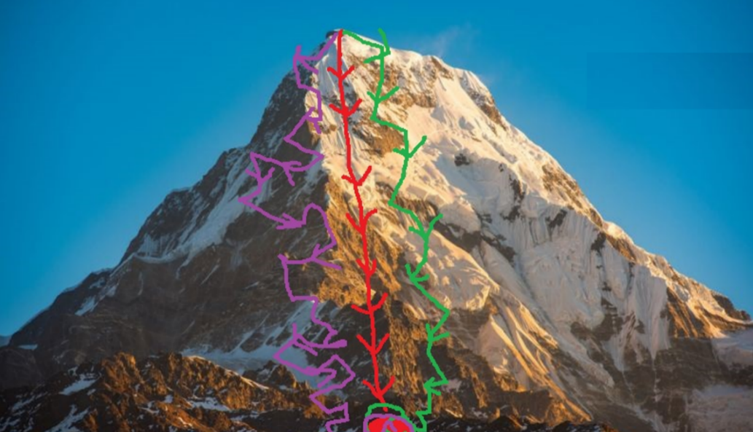
Gradient Descent
Gradient descent is a first-order optimization algorithm, also known as steepest descent.
To find the local minimum of an objective function (or loss function), it is necessary to move a certain distance in the negative direction of the gradient (or approximate gradient) corresponding to the current point of the function, and implement iterative search.
Figure 2 Gradient over ridges

Slide 17
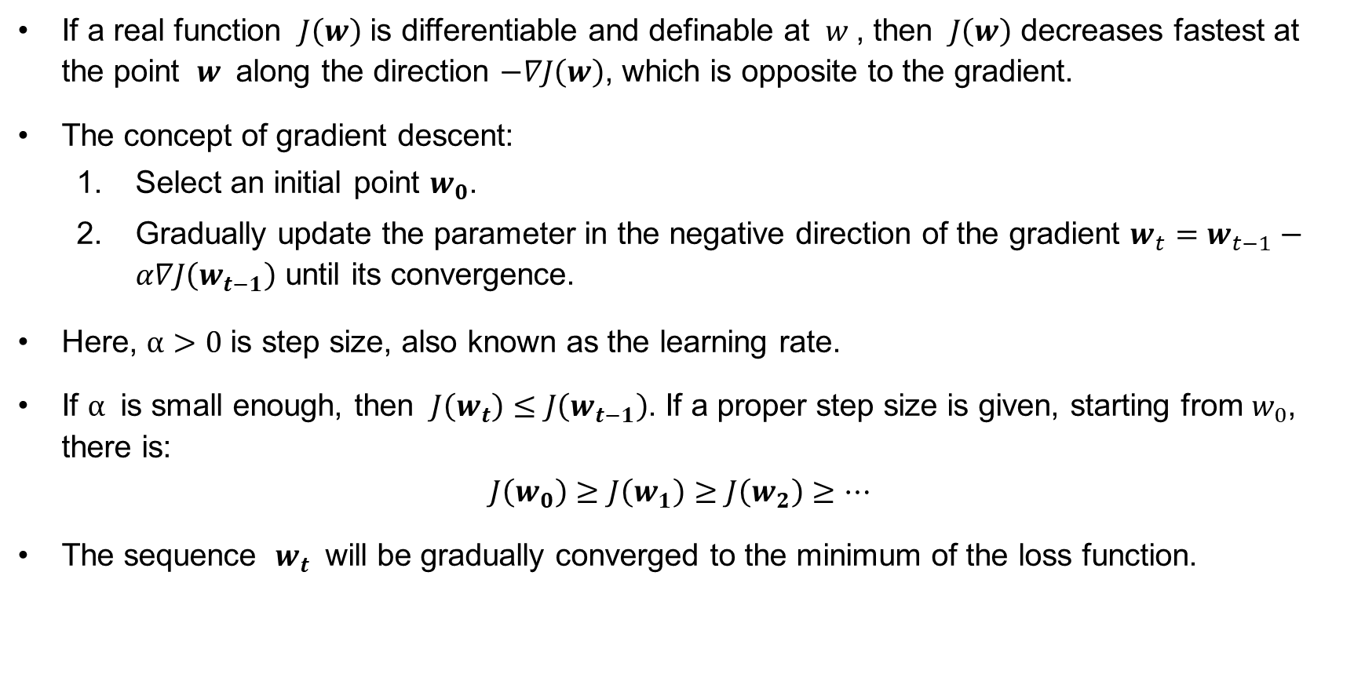
Definition
If a real function $J\left(w\right)$ is differentiable and definable at $w$, then $J\left(w\right)$ decreases fastest at the point $w$ along the direction $−∇J\left(w\right)$, which is opposite to the gradient.
The concept of gradient descent:
Select an initial point $w_{0}$.
Gradually update the parameter in the negative direction of the gradient $w_{t}=w_{t−1}−α∇J\left(w_{t−1}\right)$ until its convergence.
Here, $α>0$ is step size, also known as the learning rate.
If $α$ is small enough, then $J\left(w_{t}\right)≤J\left(w_{t−1}\right)$. If a proper step size is given, starting from $w_{0}$, there is:
$$J\left(w_{0}\right)≥J\left(w_{1}\right)≥J\left(w_{2}\right)≥⋯$$
The sequence $w_{t}$ will be gradually converged to the minimum of the loss function.

Slide 18
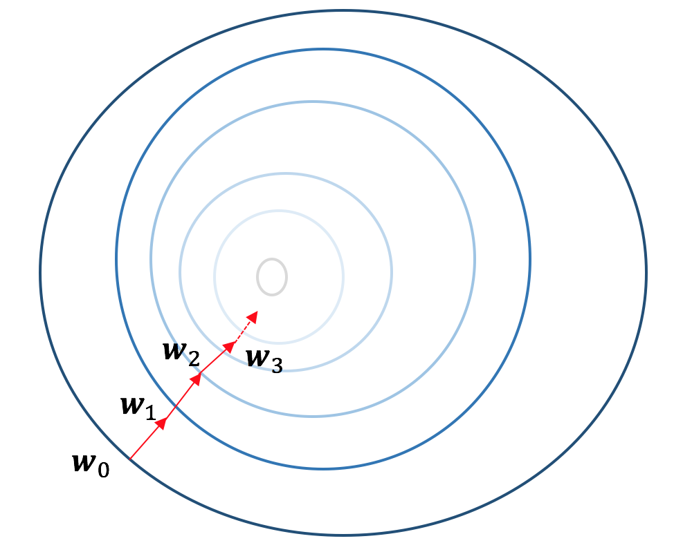
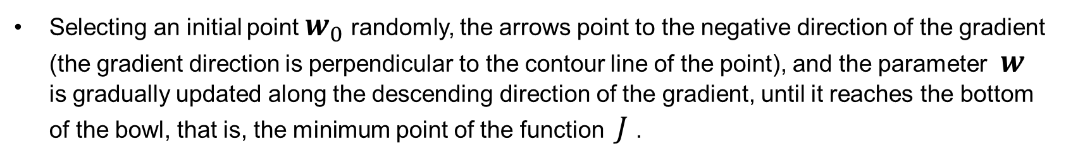
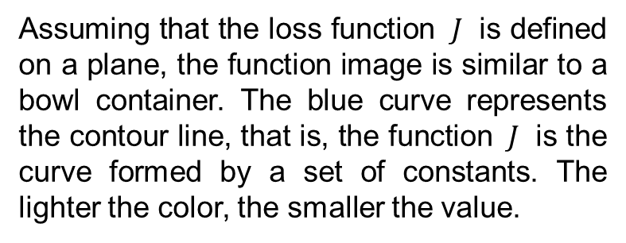
Description
Assuming that the loss function $J$ is defined on a plane, the function image is similar to a bowl container. The blue curve represents the contour line, that is, the function $J$ is the curve formed by a set of constants. The lighter the color, the smaller the value.
Selecting an initial point $w_{0}$ randomly, the arrows point to the negative direction of the gradient (the gradient direction is perpendicular to the contour line of the point), and the parameter $w$ is gradually updated along the descending direction of the gradient, until it reaches the bottom of the bowl, that is, the minimum point of the function $J$.

Slide 19
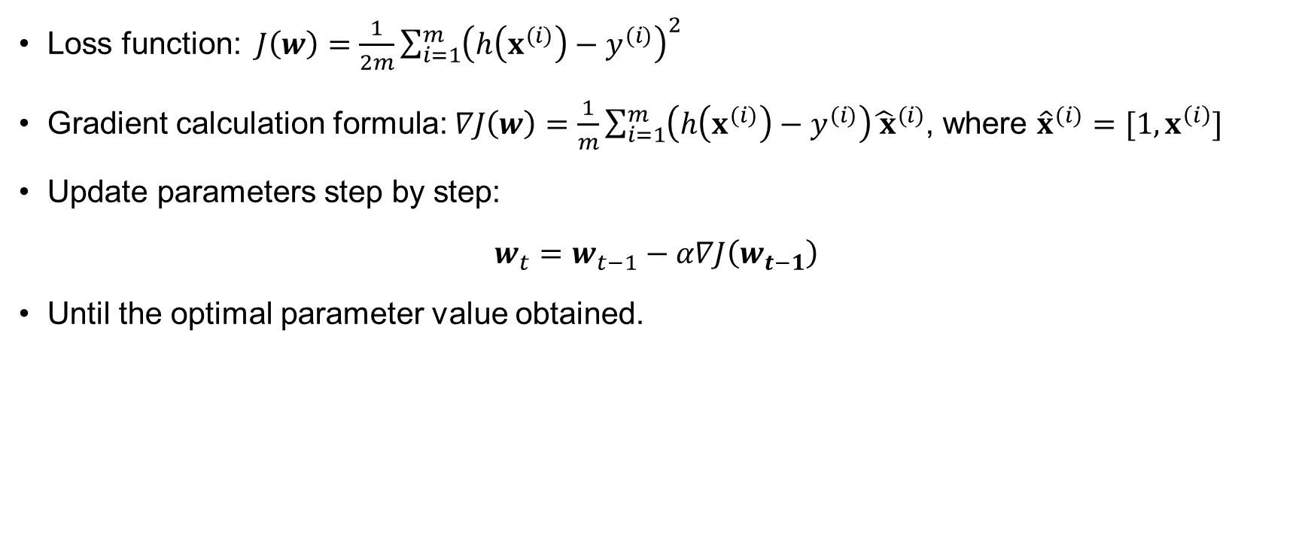
Pseudo-code
Loss function: $J\left(w\right)=\frac{1}{2m}\sum_{i=1}^{m}{{\left(h\left(x^{(i)}\right)−y^{(i)}\right)}^{2}}$
Gradient calculation formula: $∇J\left(w\right)=\frac{1}{m}\sum_{i=1}^{m}{\left(h\left(x^{(i)}\right)−y^{(i)}\right){\hat{ x}}^{(i)}}$, where ${\hat{x}}^{(i)}=[1,x^{\left(i\right)}]$
Update parameters step by step:
$w_{t}=w_{t−1}−α∇J\left(w_{t−1}\right)$
Until the optimal parameter value obtained.

Slide 20
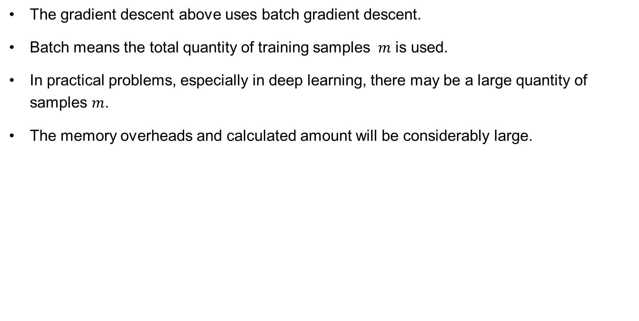
Batch Gradient Descent
The gradient descent above uses batch gradient descent.
Batch means the total quantity of training samples $m$ is used.
In practical problems, especially in deep learning, there may be a large quantity of samples $m$.
The memory overheads and calculated amount will be considerably large.

Slide 21
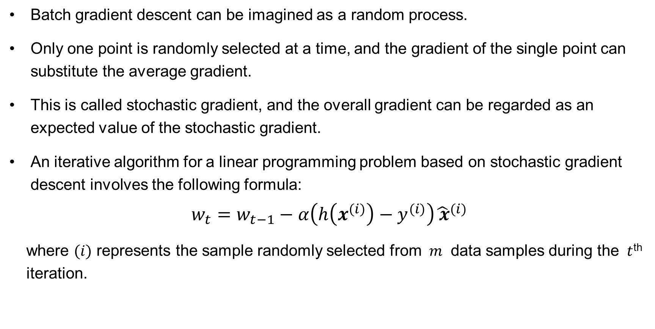
Stochastic Gradient Descent
Batch gradient descent can be imagined as a random process.
Only one point is randomly selected at a time, and the gradient of the single point can substitute the average gradient.
This is called stochastic gradient, and the overall gradient can be regarded as an expected value of the stochastic gradient.
An iterative algorithm for a linear programming problem based on stochastic gradient descent involves the following formula:
$$w_{t}=w_{t−1}−α\left(h\left(x^{(i)}\right)−y^{(i)}\right){\hat{ x}}^{(i)}$$
where $(i)$ represents the sample randomly selected from $m$ data samples during the $t$^{th} iteration.

Slide 22
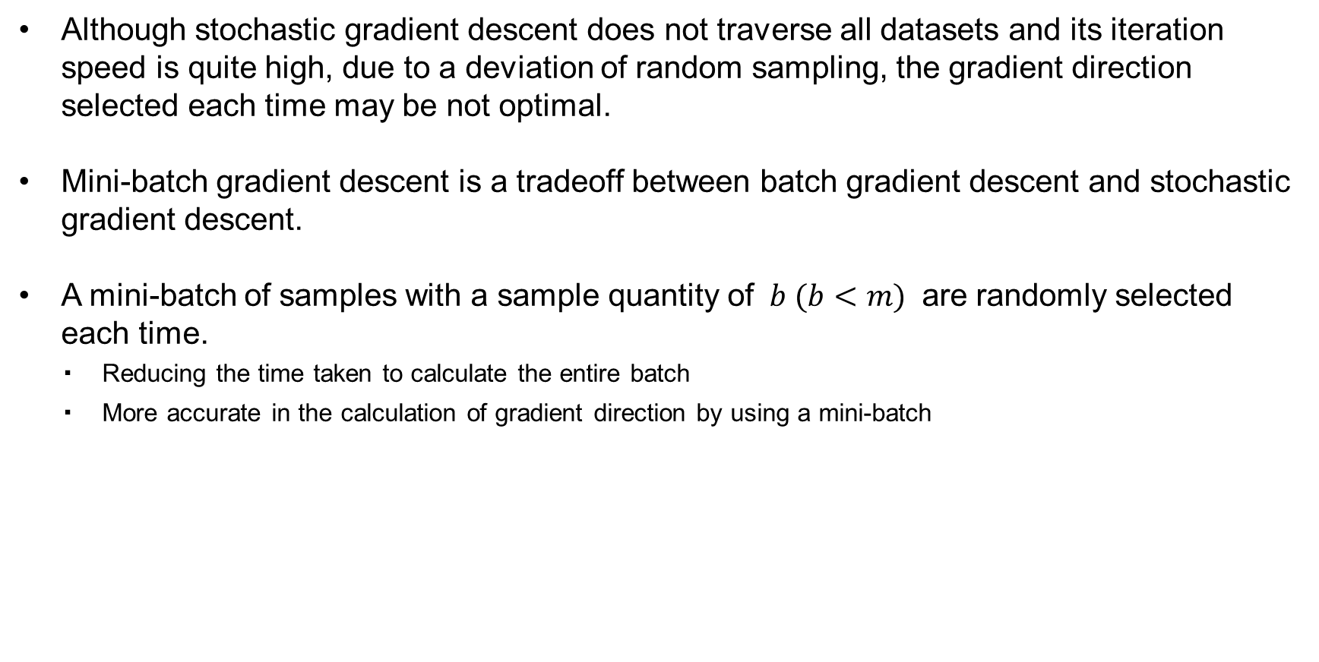
Mini-batch Gradient Descent
Although stochastic gradient descent does not traverse all datasets and its iteration speed is quite high, due to a deviation of random sampling, the gradient direction selected each time may be not optimal.
Mini-batch gradient descent is a tradeoff between batch gradient descent and stochastic gradient descent.
A mini-batch of samples with a sample quantity of $b (b<m)$ are randomly selected each time.
Reducing the time taken to calculate the entire batch
More accurate in the calculation of gradient direction by using a mini-batch

Slide 23
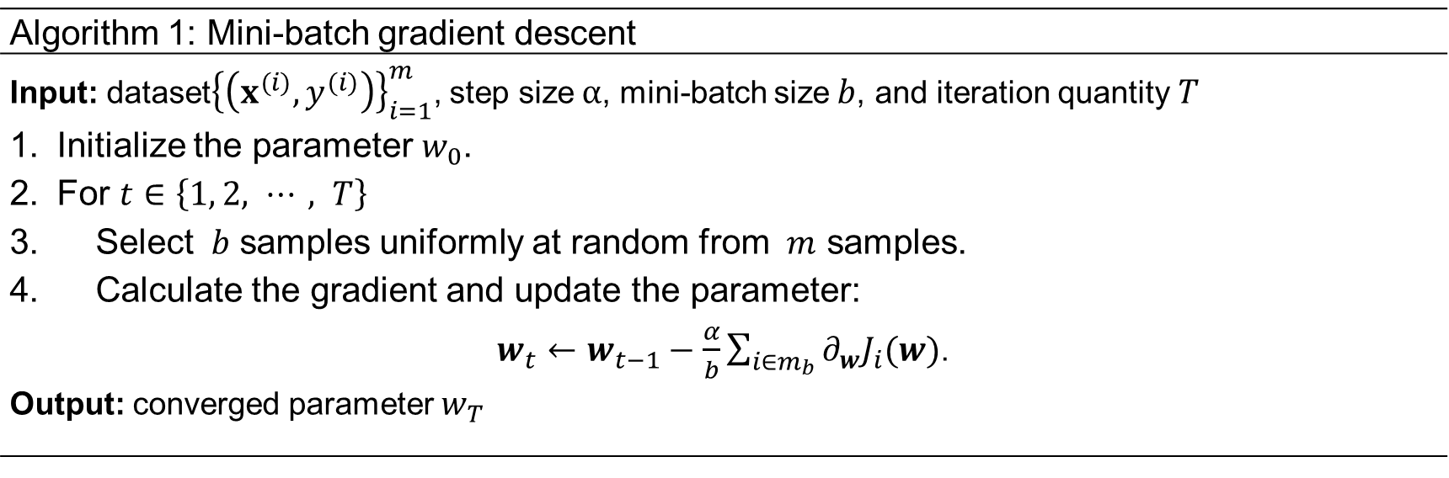
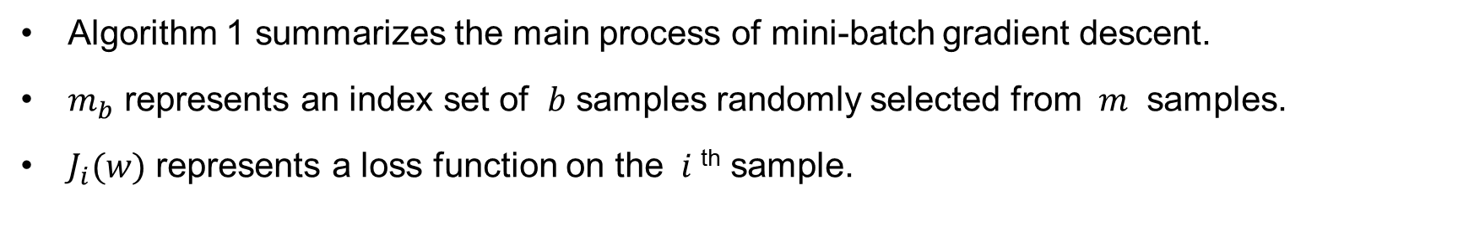
Mini-batch Gradient Descent
Algorithm 1: Mini-batch gradient descent
Input: dataset${\left\{\left(x^{(i)}, y^{(i)}\right)\right\}}_{i=1}^{m}$, step size$α$, mini-batch size$b$, and iteration quantity$T$ Initialize the parameter $w_{0}$. For $t∈\left\{1, 2, ⋯, T\right\}$ Select $b$ samples uniformly at random from $m$ samples. Calculate the gradient and update the parameter: $w_{t}←w_{t−1}−\frac{α}{b}\sum_{i∈m_{b}}{{∂_{w}J}_{i}(w)}$. Output: converged parameter $w_{T}$
Algorithm 1 summarizes the main process of mini-batch gradient descent.
$m_{b}$ represents an index set of $b$ samples randomly selected from $m$ samples.
$J_{i}(w)$ represents a loss function on the $i$^{th} sample.

Slide 24
Contents
Regression
Gradient Descent
Classification
Overfitting and Underfitting

Slide 25
Classification
Unlike regression problems, the output of classification is a discrete value rather than a continuous value, that is, the category of the sample.
Usage scenarios:
Image classification
Handwritten digit recognition
Email spam classification
Facial Recognition
…
Classification problems include binary classification ("yes" or "no") and multi-class classification (one of multiple categories is to be determined). All multi-class classification problems can be converted into multiple binary classification problems.

Slide 26
Converted to Regression
The main difference is that a series of discrete values rather than a straight line or a curve are to be fit.
Linear regression is used for linear regression problems.
Logistic regression can well fit binary classification problems.

Slide 27
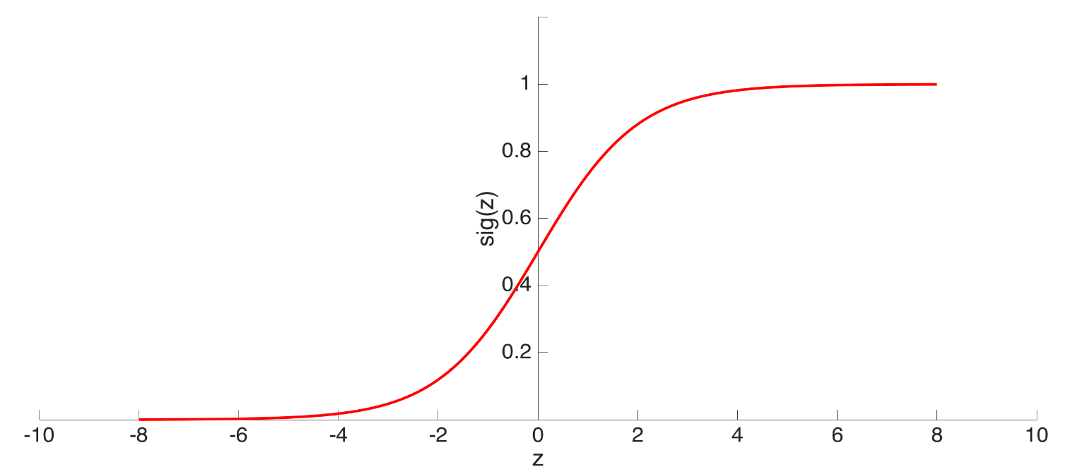
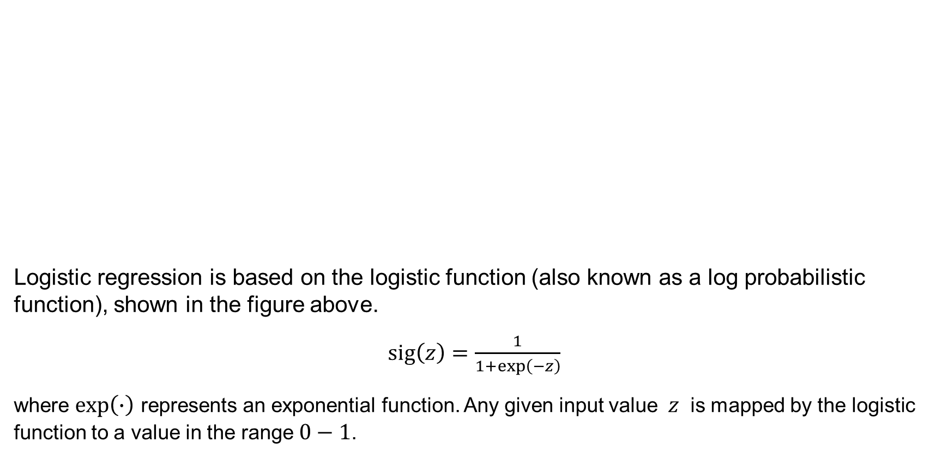
Logistic Regression
Logistic regression is based on the logistic function (also known as a log probabilistic function), shown in the figure above.
$sig\left(z\right)=\frac{1}{1+exp\left(−z\right)}$
where $exp\left(∙\right)$ represents an exponential function. Any given input value $z$ is mapped by the logistic function to a value in the range $0−1$.

Slide 28
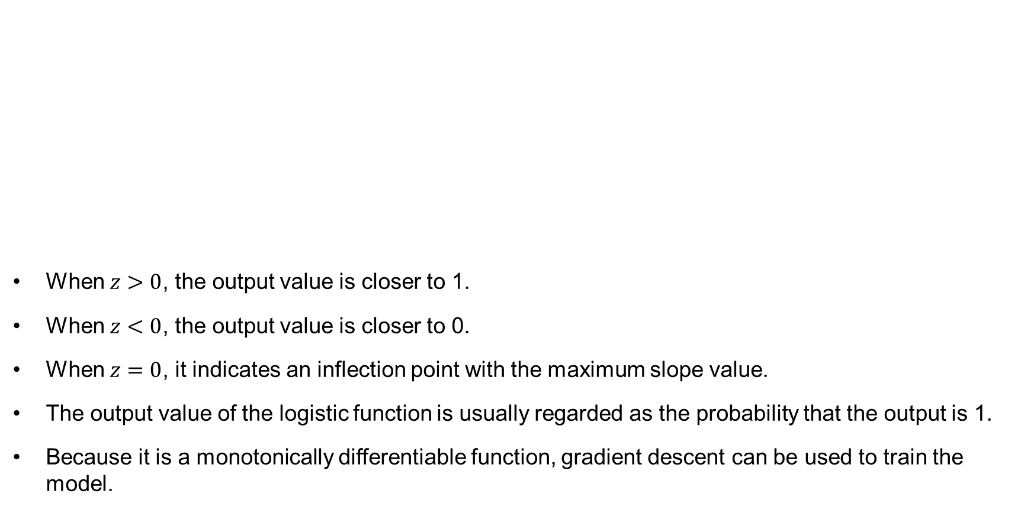
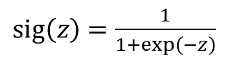
Logistic Regression
When $z>0$, the output value is closer to 1.
When $z<0$, the output value is closer to 0.
When $z=0$, it indicates an inflection point with the maximum slope value.
The output value of the logistic function is usually regarded as the probability that the output is 1.
Because it is a monotonically differentiable function, gradient descent can be used to train the model.
$sig\left(z\right)=\frac{1}{1+exp\left(−z\right)}$

Slide 29
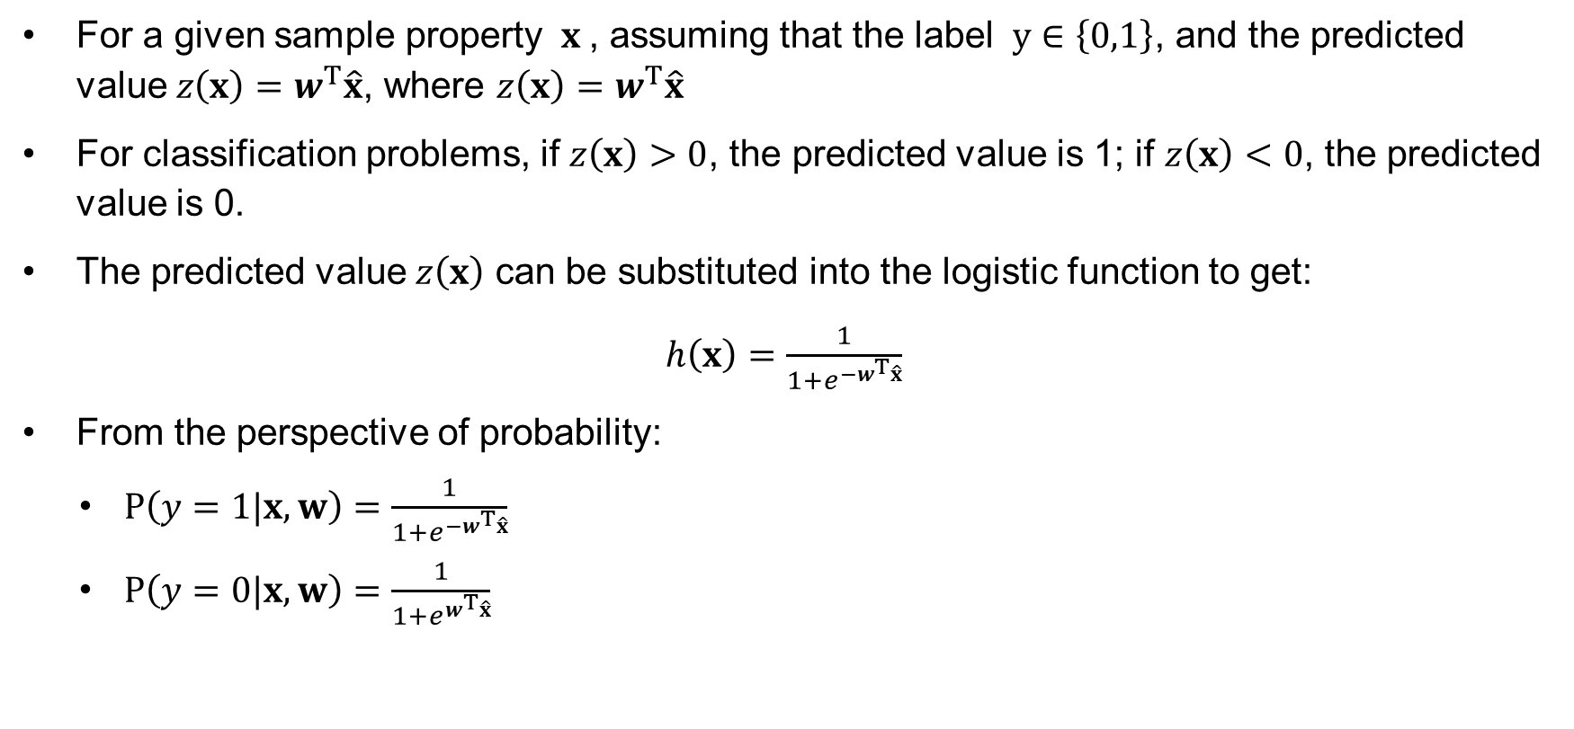
Probability Expression
For a given sample property $x$, assuming that the label $y∈\left\{0,1\right\}$, and the predicted value $z\left(x\right)=w^{T}\hat{x}$, where $z\left(x\right)=w^{T}\hat{x}$
For classification problems, if $z\left(x\right)>0$, the predicted value is 1; if $z\left(x\right)<0$, the predicted value is 0.
The predicted value $z\left(x\right)$ can be substituted into the logistic function to get:
$h\left(x\right)=\frac{1}{1+e^{−w^{T}\hat{x}}}$
From the perspective of probability:
$P\left(y=1|x,w\right)=\frac{1}{1+e^{−w^{T}\hat{x}}}$
$P\left(y=0|x,w\right)=\frac{1}{1+e^{w^{T}\hat{x}}}$

Slide 30
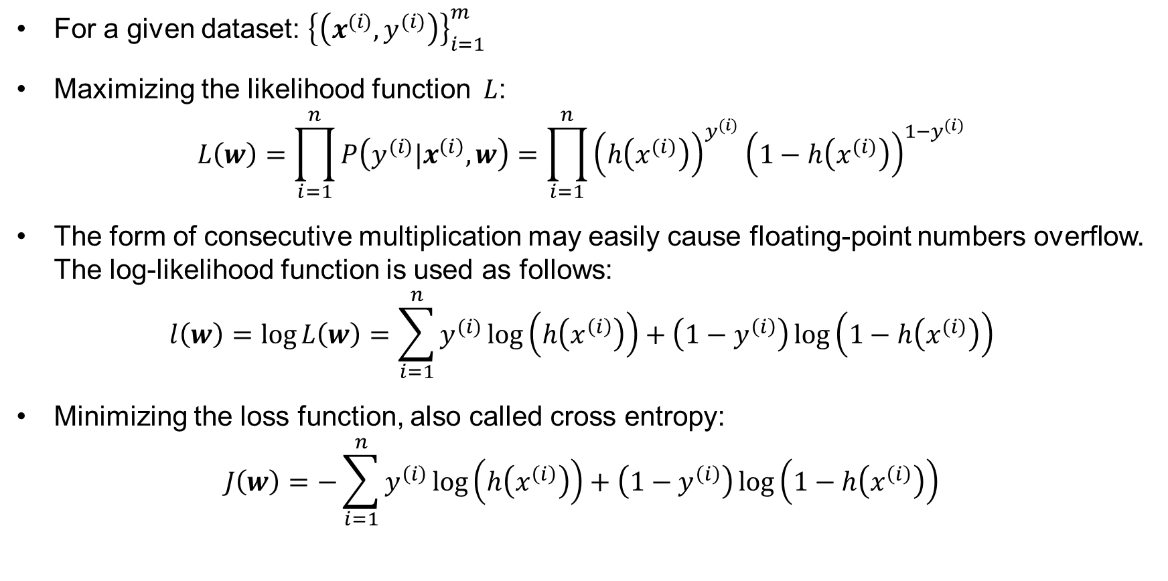
Objective Function
For a given dataset: ${\left\{\left(x^{(i)}, y^{(i)}\right)\right\}}_{i=1}^{m}$
Maximizing the likelihood function $L$:
$$L\left(w\right)=\prod_{i=1}^{n}{P\left(y^{(i)}|x^{\left(i\right)},w\right)}=\prod_{i=1}^{n}{{\left(h\left(x^{(i)}\right)\right)}^{y^{(i)}}{\left(1−h\left(x^{(i)}\right)\right)}^{1−y^{(i)}}}$$
The form of consecutive multiplication may easily cause floating-point numbers overflow. The log-likelihood function is used as follows:
$$l\left(w\right)=\log{L\left(w\right)}=\sum_{i=1}^{n}{y^{(i)}}\log\left(h\left(x^{\left(i\right)}\right)\right)+\left(1−y^{\left(i\right)}\right)\log\left(1−h\left(x^{(i)}\right)\right)$$
Minimizing the loss function, also called cross entropy:
$$J\left(w\right)=−\sum_{i=1}^{n}{y^{\left(i\right)}}\log\left(h\left(x^{\left(i\right)}\right)\right)+\left(1−y^{\left(i\right)}\right)\log\left(1−h\left(x^{\left(i\right)}\right)\right)$$

Slide 31
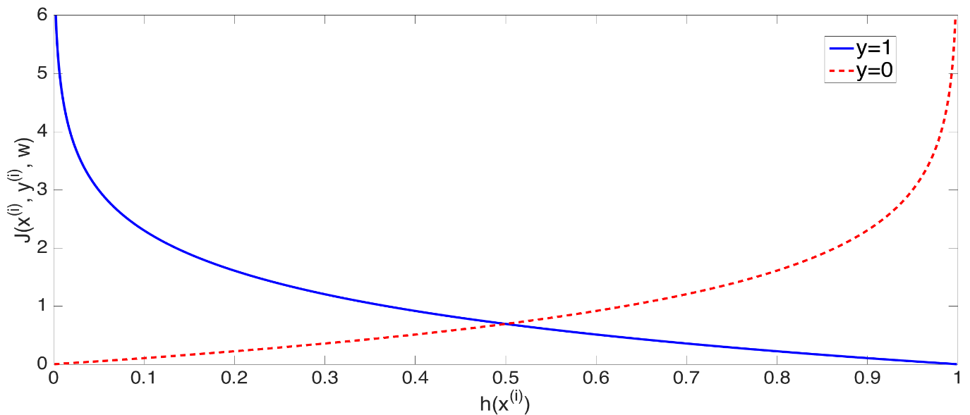
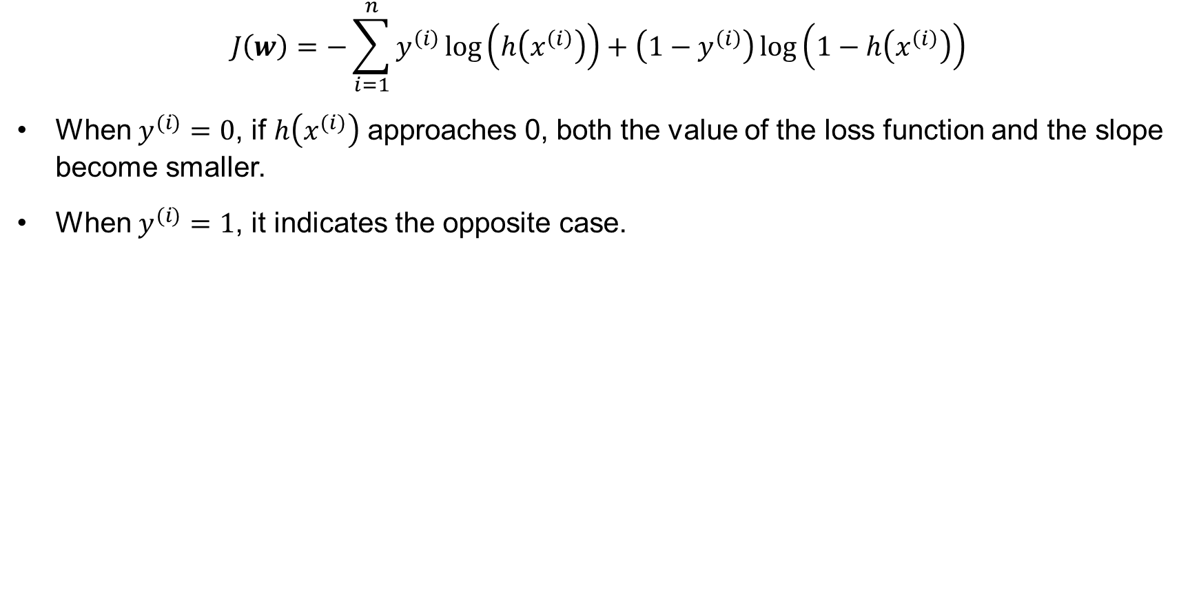
Property of Objective Function
$$J\left(w\right)=−\sum_{i=1}^{n}{y^{\left(i\right)}}\log\left(h\left(x^{\left(i\right)}\right)\right)+\left(1−y^{\left(i\right)}\right)\log\left(1−h\left(x^{\left(i\right)}\right)\right)$$
When $y^{(i)}=0$, if $h\left(x^{(i)}\right)$ approaches 0, both the value of the loss function and the slope become smaller.
When $y^{(i)}=1$, it indicates the opposite case.

Slide 32
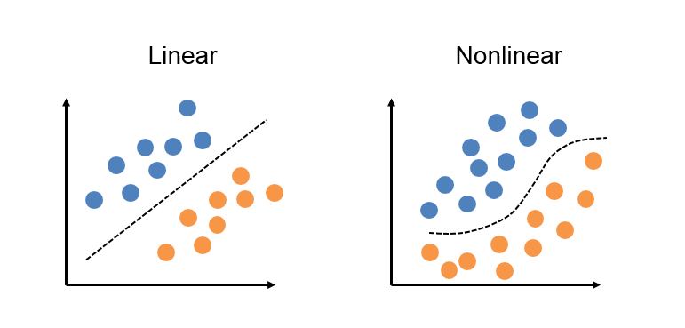
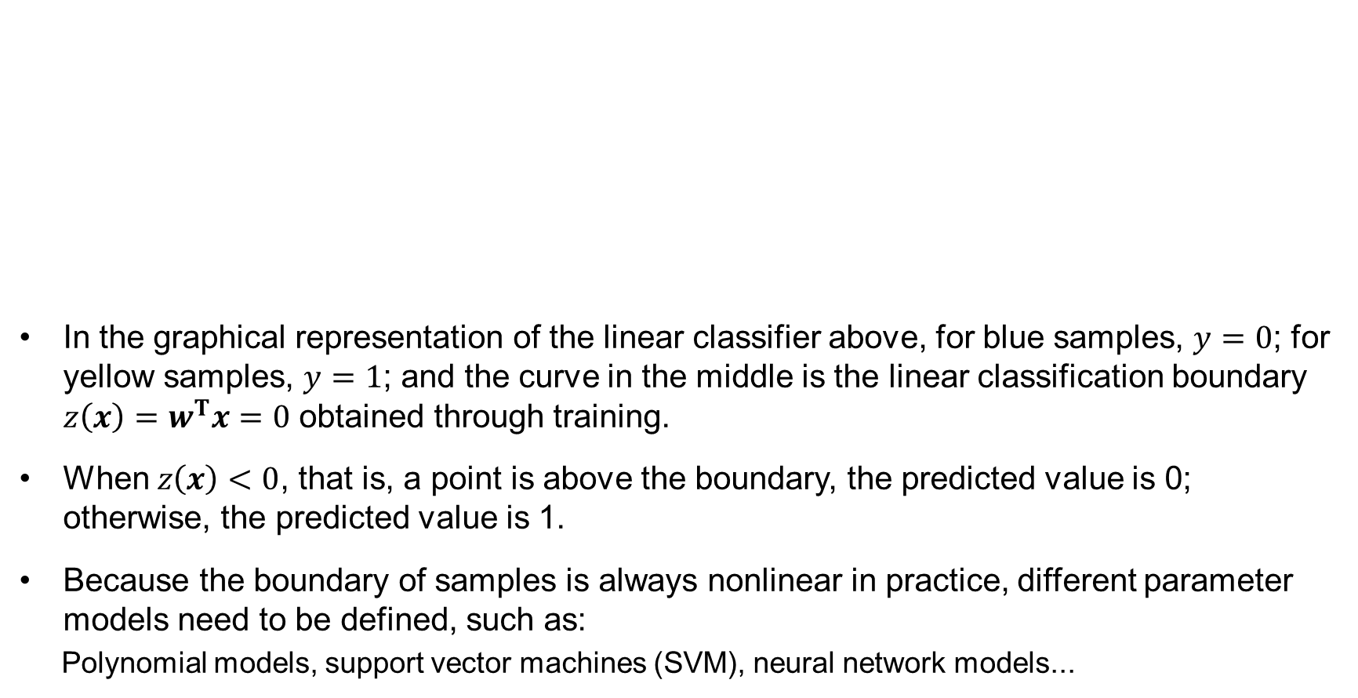
Boundary Line
In the graphical representation of the linear classifier above, for blue samples, $y=0$; for yellow samples, $y=1$; and the curve in the middle is the linear classification boundary $z\left(x\right)=w^{T}x=0$ obtained through training.
When $z\left(x\right)<0$, that is, a point is above the boundary, the predicted value is 0; otherwise, the predicted value is 1.
Because the boundary of samples is always nonlinear in practice, different parameter models need to be defined, such as:
Polynomial models, support vector machines (SVM), neural network models...

Slide 33
Contents
Regression
Gradient Descent
Classification
Overfitting and Underfitting

Slide 34
Definition
Both overfitting and underfitting reflect that the selected model does not fit the data well.
Overfitting | Underfitting
The model is too complex. | The model is too simple.
It usually includes more parameters than the features of the data. In order to fit as much data as possible, even some incorrect samples are included, and these parameters may cause some noise due to overfitting of data. | The selected parameter or model is not complex enough. For example, using a linear model to fit a nonlinear structure is obviously underfitting.

Slide 35
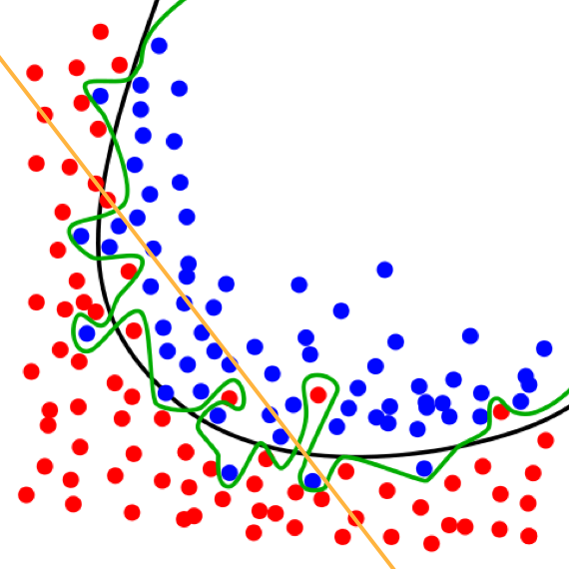
Classification
If the orange-colored linear model is used, it is obviously impossible to fit the nonlinear boundary. This case is called underfitting, in which the model cannot get a good prediction result.
Although the green-colored complex model distinguishes the data completely, the model does not fit the data features well. For a new test point, this model may cause an error in distinguishing. Such a model is called overfitting.
The curve in black is a better model having a better generalization ability.
Underfitting, and overfitting in classification problems

Slide 36

Regression
If the regression problem is fit by using a blue-colored polynomial curve, although all data points can be fit perfectly, the features of the data are lost, and the model cannot be generalized well.
The dark-colored linear model reflects a change trend of the data, and can achieve higher accuracy when predicting a new data point.
Overfitting in regression problems

Slide 37
Dataset
In machine learning, the data includes training set and testing set.
The model needs to be selected and trained based on the training set, and the testing set is invisible to the model.
An underfitting model achieves a poor effect on both training set and testing set.
An overfitting model achieves a great effect on training set, and poor effect on testing set.
Underfitting is easy to identify, whereas overfitting is not.

Slide 38
Preventing Overfitting
Extract some samples from the training set to form one validation set.
Assuming that the distribution of the validation set is similar to those of the training set and the testing set, it can be determined whether the model is overfitting based on performance of the model on the validation set.
Training set
Testing set
Validation set

Slide 39
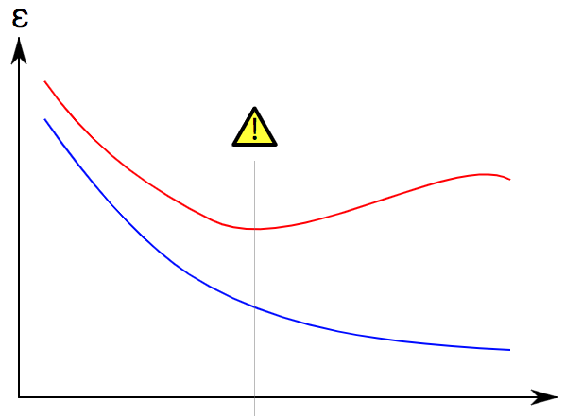
Manifestation
The horizontal coordinate represents model complexity, and the vertical coordinate represents an error value.
The blue curve represents an error on the training set, and the red curve represents an error on the validation set.
When the model complexity increases:
The error on the training set gradually decreases.
The error on the validation set first decreases and then increases.
This is the process from underfitting to overfitting.
The validation set is intended to help select the model at the dashed line. The model can best fit the data, so that a better generalization effect is expected.
Overfitting and underfitting of the model

Slide 40
Solutions
In the case of underfitting, increase the model complexity.
In the case of overfitting, which is more common, decrease the model complexity.
Generally, the following methods are used to prevent overfitting:
Re-selecting the model or adjusting its structure.
Obtaining more data
Combining multiple models
Bayes method
…
In the training method section of the deep neural network, other methods of enhancing the model's generalization ability and preventing overfitting will be introduced.

Slide 41
Summary
Regression algorithms usually use a series of properties to predict values, and the predicted values are continuous.
Gradient descent is a first-order optimization algorithm, also known as steepest descent.
To find the local minimum of a loss function (or objective function), it is necessary to move a certain distance in the negative direction of the gradient (or approximate gradient) corresponding to the current point of the function, and implement iterative search.
The output of a classification problem is a discrete value, that is, the category of the sample.
Both overfitting and underfitting reflect that the selected model does not fit the data well.
Overfitting - the model is too complex.
Underfitting - the model is too simple.

Slide 42
Practical Exercise 1
Linear_regression.ipynb

Slide 43
Deep Neural Network

Slide 44
About This Course
This part intends to explain:
Basic knowledge of deep learning
Concepts of feedforward networks, backward propagation, generalization ability
Architecture design

Slide 45
Contents
Basic Knowledge
Feedforward Network
Backward Propagation
Generalization Ability
Architecture Design

Slide 46
Basic Knowledge
Deep feedforward network, also referred to as feedforward neural network (FNN) or multi-layer perceptron (MLP), is one of the most important models in deep learning.
The objective of the feedforward network is to approach certain functions $f^{∗}$. For example, a classification function $f^{∗}\left(x\right)=y$ maps an input to a class. Then, the objective of feedforward network is to define a mapping function $f(x;θ)$ and learn the parameters $θ$ that can maximize this function's approach to $f^{∗}\left(x\right)$.

Slide 47
Basic Knowledge
The feedforward network is essentially a combination of functions.
For example, three functions $f^{\left(1\right)}$, $f^{\left(2\right)}$, $f^{\left(3\right)}$ are defined for a network, and linked in a chain.
$$f\left(x\right)=f^{\left(3\right)}(f^{\left(2\right)}(f^{\left(1\right)}(x)))$$
In this case, $f^{\left(1\right)}$ is the first layer, $f^{\left(2\right)}$ is the second layer, and so on.
The first layer is an input layer, the last layer is an output layer, and the middle layers are collectively referred to as hidden layers.
Depth refers to the length of the chain, and width refers to the number of neurons at the hidden layers.

Slide 48
Basic Knowledge
Neurons are an important part of the deep learning network model.
The hidden layer consists of many parallel units, each representing a function whose input is a vector and output is a scalar.
The idea of multi-level vector values originates from neuroscience. However, modern research on neural networks is guided by many mathematics and engineering disciplines. The objective of neural network is not to model the brain perfectly.
Instead of considering feedforward networks as a brain function model, it is better to view them as function-approximate machines, designed to generalize statistics and occasionally draw some insights from our understanding of the brain.

Slide 49
Contents
Basic Knowledge
Feedforward Network
Backward Propagation
Generalization Ability
Architecture Design

Slide 50
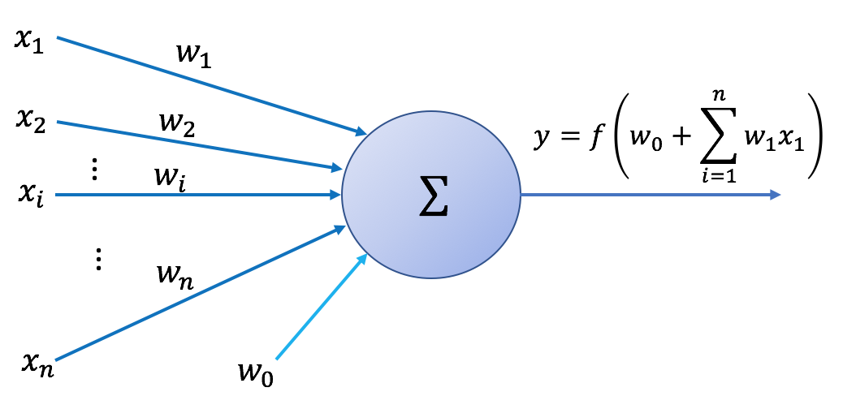
Feedforward Network
The biggest difference between deep learning and traditional machine learning is that the former uses neural networks to perform high-level data abstraction. The most basic neural network structure is feedforward neural network (FNN), also known as MLP.
Notes:
Multilayer Perceptron

Slide 51
Perceptron
Before introducing the MLP, we first introduce the basic unit of a neural network—perceptron.
$x_{1}, x_{2}, ⋯, x_{n}$ are inputs, $w_{1}, w_{2}, ⋯, w_{n}$ are corresponding weights, and $w_{0}$ is a bias. The perceptron performs weighted summation on these inputs, adds the bias $w_{0}$, and finally obtains the outputs of neurons by using the activation function $f\left(∙\right)$.

Slide 52
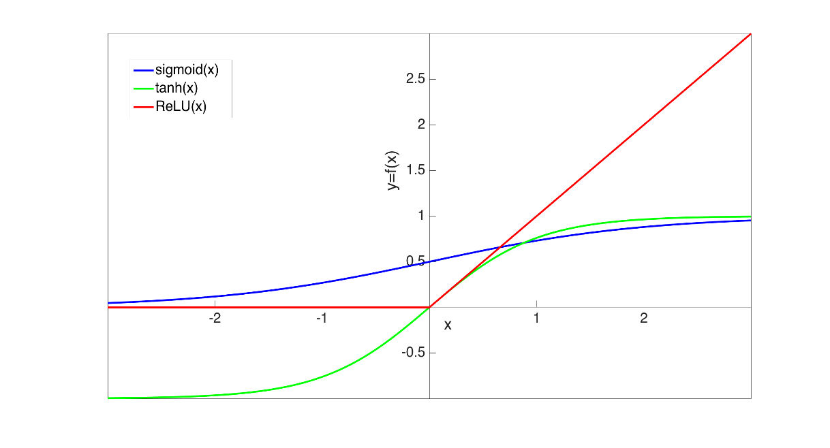
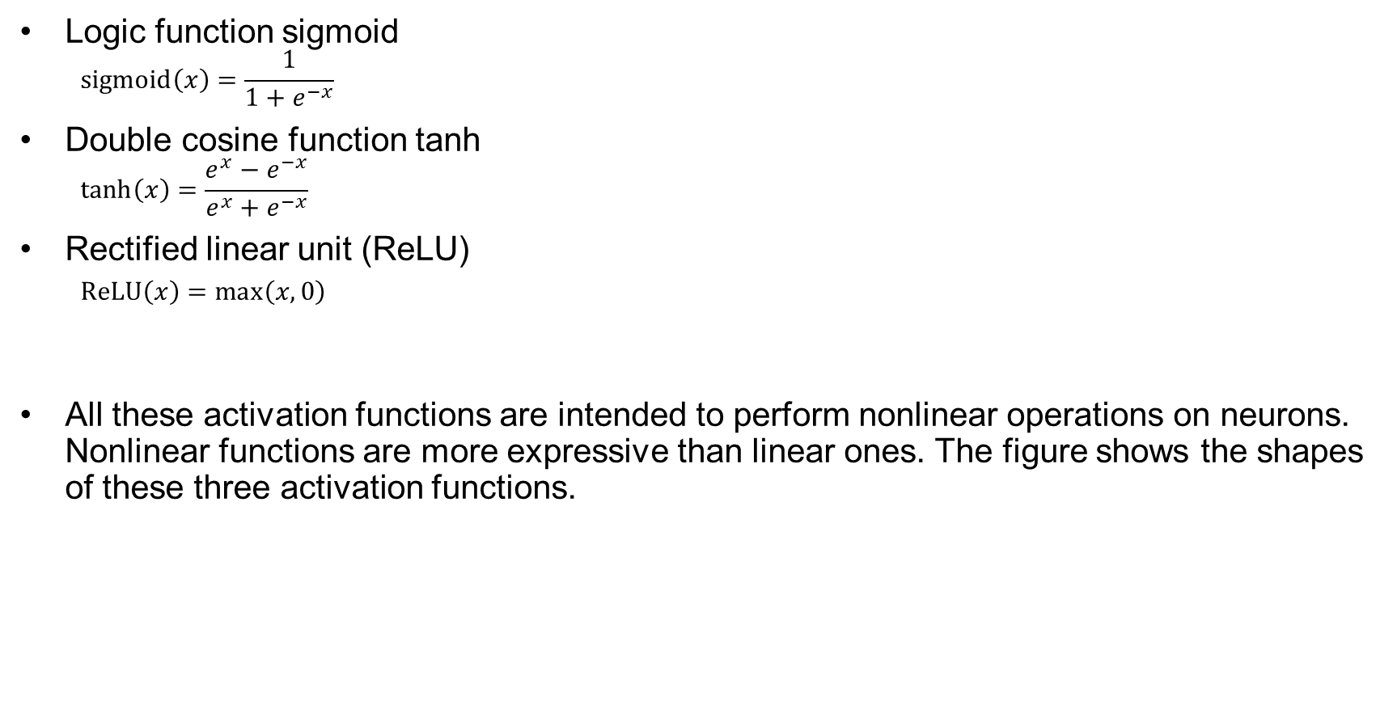
Common Activation Functions
Logic function sigmoid
$$sigmoid\left(x\right)=\frac{1}{1+e^{−x}}$$
Double cosine function tanh
$$\tanh\left(x\right)=\frac{e^{x}−e^{−x}}{e^{x}+e^{−x}}$$
Rectified linear unit (ReLU)
$ReLU\left(x\right)=\max\left(x,0\right)$
All these activation functions are intended to perform nonlinear operations on neurons. Nonlinear functions are more expressive than linear ones. The figure shows the shapes of these three activation functions.

Slide 53
Activation Function Description
Logic function sigmoid
$$sigmoid\left(x\right)=\frac{1}{1+e^{−x}}$$
$sigmoid$ is used to squeeze a value that changes within a large range to an output value range of (0,1).
Saturation in most of the $sigmoid$ fields: When the input is positive, saturation is high; otherwise, saturation is low. When the input value is close to 0, the sigmoid is ultra-sensitive.
The wide saturation of $sigmoid$ makes gradient-based learning considerably difficult. Therefore, sigmoid functions are not commonly used as hidden units in feedforward networks.
In gradient-based deep learning, $sigmoid$ is often used as an output unit.

Slide 54
Activation Function Description
Double cosine function tanh
$$\tanh\left(x\right)=\frac{e^{x}−e^{−x}}{e^{x}+e^{−x}}$$
In terms of activation functions, $tanh$ is usually more appropriate than $sigmoid$.
$tanh$ is more similar to an identity function around 0. For example, $\tanh\left(0\right)=0$ but $sigmoid\left(0\right)=0.5$, making it easier to train a deep neural network.

Slide 55
Activation Function Description
ReLU
$$ReLU\left(x\right)=\max\left(x,0\right)$$
$ReLU$ is very similar to linear units, and therefore easy to optimize. The only difference between them is that 0 is the output in the half field of $ReLU$.
This allows the derivative of the ReLU to remain large when the unit is activated.
The gradients are not only large but also consistent. At almost every point, the second derivative of $ReLU$ is 0, and its derivative is 1. This means that for learning, gradient orientation is more useful than introducing second-order effects into activation functions.
One drawback of $ReLU$ is that samples activated to 0 cannot be learned through a gradient-based approach.

Slide 56
Additional Activation Functions
Some uncommon activation functions include:
Softplus activation function
$$softplus\left(x\right)=\log{(1+e^{x})}$$
Hard tanh activation function
$$hard\left(x\right)=\max{(−1,\min{(1,a)})}$$
The design of activation functions is still an active research field, and many useful activation functions are yet to be discovered.

Slide 57
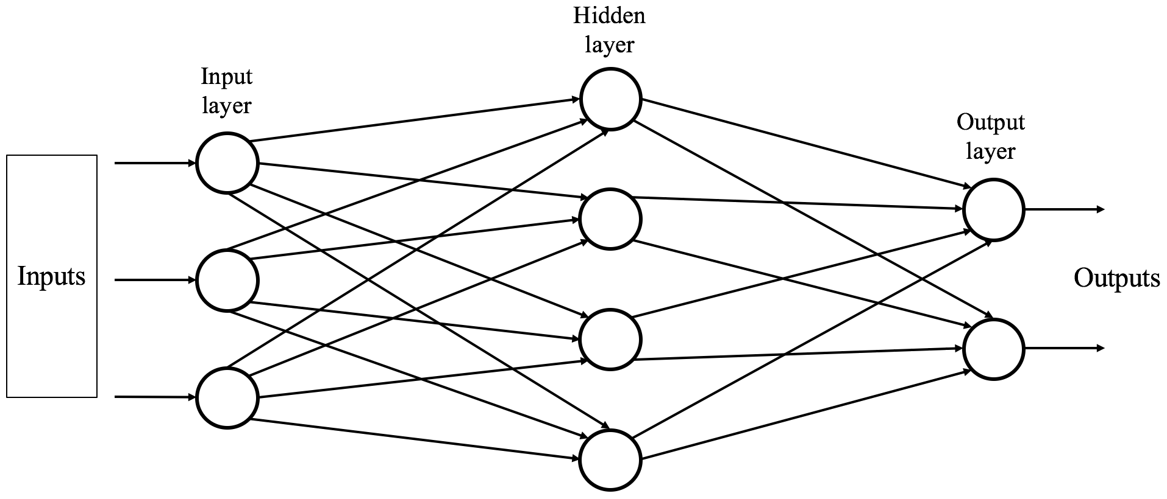
MLP
Although a single neuron of a nonlinear activation function has a nonlinear feature, the nonlinear activation function has only one layer of neurons and a very limited learning ability, and can only deal with the linearly separable problem. Therefore, the MLP is proposed to solve more complicated nonlinearly separable problems.

Slide 58
MLP
A simple three-layer FNN model, shown in the figure, that includes an input layer, a hidden layer, and an output layer.
Data $x$ is provided to the input layer as inputs, and the input data is processed through linear mapping and nonlinear activation functions at the hidden layer. The processed data is then transferred to the output layer.
The number of nodes at the input layer depends on the number of properties of the data, and the number of nodes at the output layer can be the number of categories, the number of abstract features, and so on.
The number of hidden layers is specified manually, and there may be one or more hidden layers. One category of nonlinear activation functions can be set at each hidden layer. After linear combination and nonlinear transformation, the function model formed by multiple layers of neurons develops a more powerful learning ability.

Slide 59
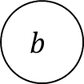
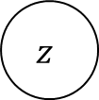
Computational Graph
We have discussed neural networks in a relatively informal graphical language. To describe the backward propagation algorithm more accurately, we now introduce a more accurate computational graph language.
Each node represents a variable. Variables can be scalars, vectors, matrices, or tensors.
Each edge represents an operation, which is a simple function of one or more variables.
$$H$$
$$z$$
$$ReLU$$
$$h^{1}$$
$$h^{2}$$
$$×$$
$$+$$
$$x$$
$$y$$
$$x$$
$$matmul$$
$$W$$
$$b$$

Slide 60
Contents
Basic Knowledge
Feedforward Network
Backward Propagation
Generalization Ability
Architecture Design

Slide 61
Backward Propagation
The nonlinearity of neural networks can cause the most interesting loss function to become non-convex. This means that neural network training is different from convex optimization algorithms in logistic regression or support vector machines.
Currently, training algorithms are always based on gradients, reducing the loss function through a certain method. We will now introduce an improved algorithm for stochastic gradient descent — backward propagation.

Slide 62
Backward Propagation
The backward propagation algorithm is used in neural networks to make the gradient calculation more efficient.
Chain rule: assume that there are two functions $y=g\left(x\right)$ and $z=h\left(y\right)$. The derivative of $z$ with respect to $x$ is obtained as follows:
$$\frac{∂z}{∂x}=\frac{∂z}{∂y} \frac{∂y}{∂x} .$$
Assume that there are three functions $x=g\left(s\right)$, $y=h\left(s\right)$, and $z=k\left(x,y\right)$. The derivative of $z$ with respect to $s$ is obtained as follows:
$$\frac{∂z}{∂s}=\frac{∂z}{∂x}\frac{∂x}{∂s}+ \frac{∂z}{∂y}\frac{∂y}{∂s} .$$
The gradient calculation of neural networks relies on layer-by-layer backward propagation based on the chain rule.

Slide 63
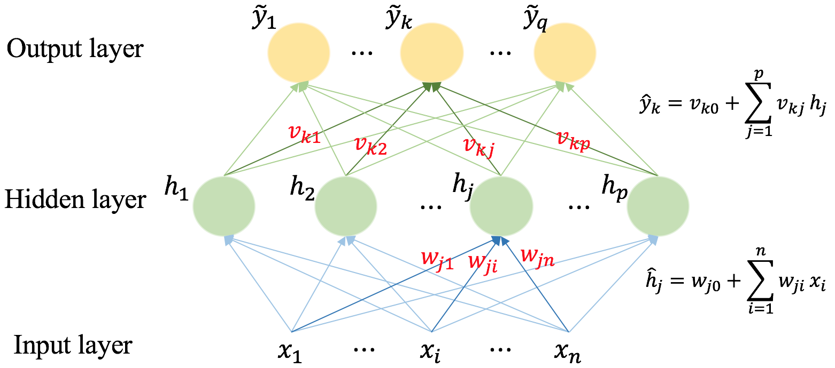
Backward Propagation
In the FNN, the input layer includes $n$ properties $x_{1},⋯x_{n}$; the intermediate hidden layer includes $p$ neurons; the output layer has $q$ dimensions.
For each neuron $h_{j}$ at the hidden layer, linear transformation is first performed by ${\hat{h}}_{j}=w_{j0}+\sum_{i=1}^{n}{w_{ji}x_{i}}$, where $w_{j0}$ is a bias, and $w_{j1}⋯w_{jn}$ are weights applied to properties $x_{1},⋯x_{n}$. After ${\hat{h}}_{j}$ is input to the neuron, $h_{j}=α_{1}\left({\hat{h}}_{j}\right)$ is obtained after the activation function is applied.
Similarly, a neuron is input at the second layer: ${\hat{y}}_{k}=v_{k0}+\sum_{j=1}^{p}{v_{kj}x_{j}}$, and ${\tilde{y}}_{j}=α_{2}\left({\hat{y}}_{j}\right)$ is output.

Slide 64
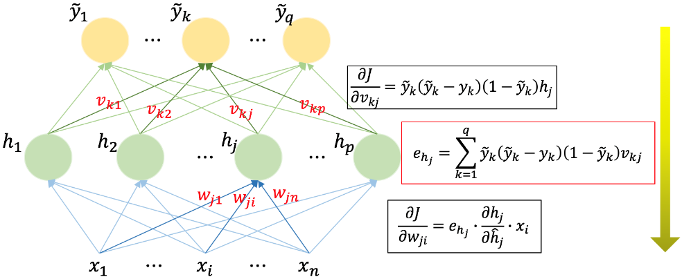
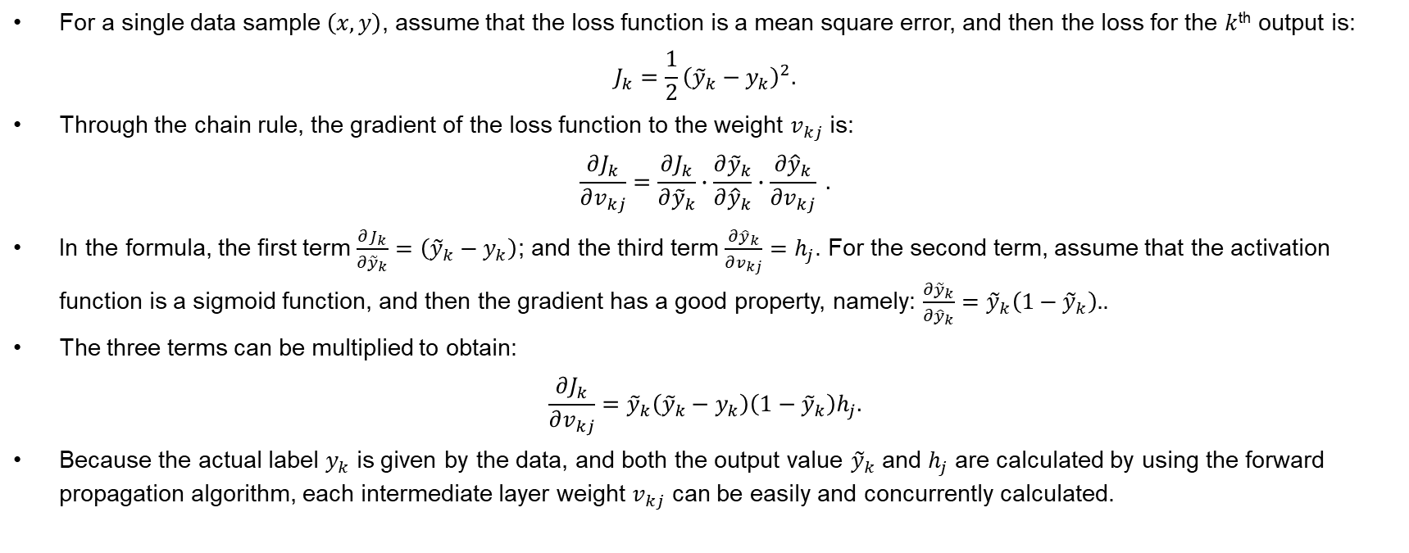
Backward Propagation
For a single data sample $\left(x, y\right)$, assume that the loss function is a mean square error, and then the loss for the $k$^{th} output is:
$$J_{k}=\frac{1}{2}{\left({\tilde{y}}_{k}−y_{k}\right)}^{2}.$$
Through the chain rule, the gradient of the loss function to the weight $v_{kj}$ is:
$$\frac{∂J_{k}}{∂v_{kj}}=\frac{∂J_{k}}{{∂\tilde{y}}_{k}}∙\frac{{∂\tilde{y}}_{k}}{{∂\hat{y}}_{k}}∙\frac{{∂\hat{y}}_{k}}{∂v_{kj}} .$$
In the formula, the first term $\frac{∂J_{k}}{{∂\tilde{y}}_{k}}=\left({\tilde{y}}_{k}−y_{k}\right)$; and the third term $\frac{{∂\hat{y}}_{k}}{∂v_{kj}}=h_{j}$. For the second term, assume that the activation function is a sigmoid function, and then the gradient has a good property, namely: $\frac{{∂\tilde{y}}_{k}}{{∂\hat{y}}_{k}}={\tilde{y}}_{k}\left(1−{\tilde{y}}_{k}\right).$.
The three terms can be multiplied to obtain:
$$\frac{∂J_{k}}{∂v_{kj}}={\tilde{y}}_{k}\left({\tilde{y}}_{k}−y_{k}\right)\left(1−{\tilde{y}}_{k}\right)h_{j}.$$
Because the actual label $y_{k}$ is given by the data, and both the output value ${\tilde{y}}_{k}$ and $h_{j}$ are calculated by using the forward propagation algorithm, each intermediate layer weight $v_{kj}$ can be easily and concurrently calculated.

Slide 65
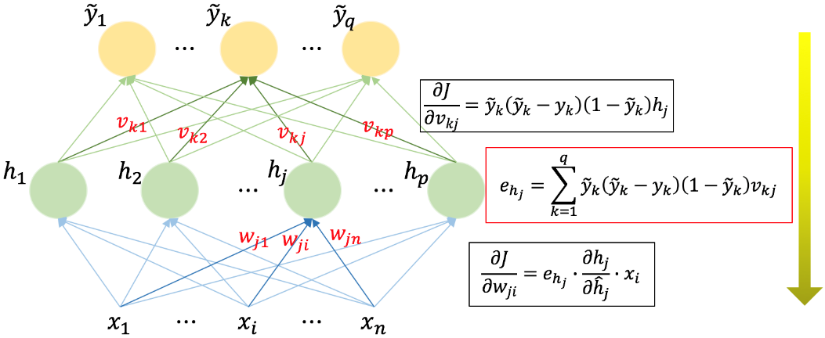
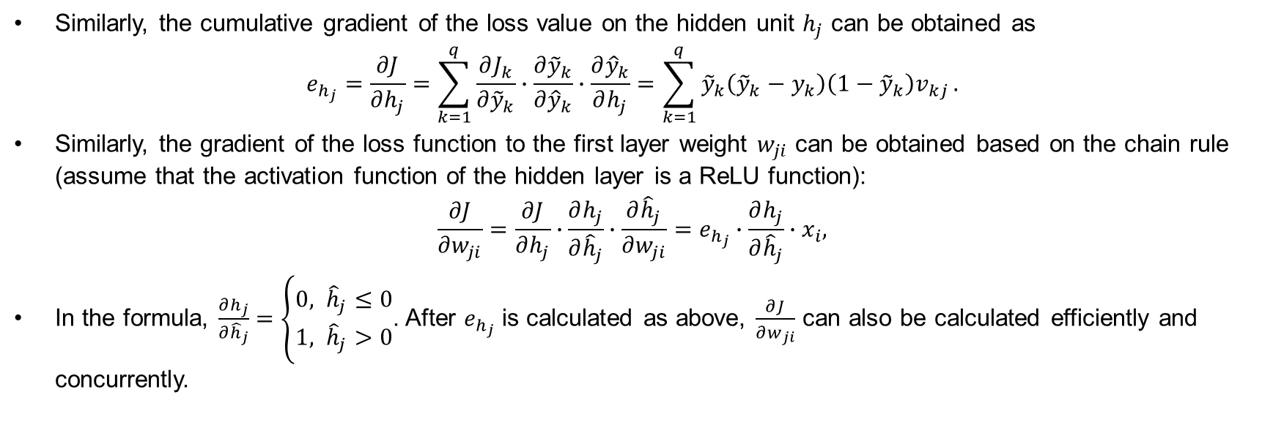
Backward Propagation
Similarly, the cumulative gradient of the loss value on the hidden unit $h_{j}$ can be obtained as
$$e_{h_{j}}=\frac{∂J}{∂h_{j}}=\sum_{k=1}^{q}{\frac{∂J_{k}}{{∂\tilde{y}}_{k}}∙\frac{{∂\tilde{y}}_{k}}{{∂\hat{y}}_{k}}∙\frac{∂{\hat{y}}_{k}}{∂h_{j}}}=\sum_{k=1}^{q}{{\tilde{y}}_{k}\left({\tilde{y}}_{k}−y_{k}\right)\left(1−{\tilde{y}}_{k}\right)v_{kj}}.$$
Similarly, the gradient of the loss function to the first layer weight $w_{ji}$ can be obtained based on the chain rule (assume that the activation function of the hidden layer is a ReLU function):
$$\frac{∂J}{∂w_{ji}}=\frac{∂J}{∂h_{j}}∙\frac{∂h_{j}}{∂{\hat{h}}_{j}}∙\frac{∂{\hat{h}}_{j}}{∂w_{ji}}=e_{h_{j}}∙\frac{∂h_{j}}{∂{\hat{h}}_{j}}∙x_{i},$$
In the formula, $\frac{∂h_{j}}{∂{\hat{h}}_{j}}=\left\{\begin{aligned}0, {\hat{h}}_{j}≤0 \\ 1, {\hat{h}}_{j}>0\end{aligned}\right.$. After $e_{h_{j}}$ is calculated as above, $\frac{∂J}{∂w_{ji}}$ can also be calculated efficiently and concurrently.

Slide 66
Backward Propagation
In the above process, it is assumed that the loss function is a mean variance error and the activation functions are sigmoid and ReLU functions. Actually, this calculation rule is effective for any differentiable loss function and activation function.
As can be seen from the calculation process, after the values of the hidden layer and the output layer are obtained through forward propagation, the gradient is calculated starting from the loss function and then the top layer, and the gradient is propagated layer-by-layer to the input layer. This is reverse to the sequence of forward propagation, and therefore the algorithm is called backward propagation.
After the gradients of all parameters are obtained through backward propagation, the gradient descent algorithm can be used to update and iterate the parameters, and the neural network is trained.

Slide 67
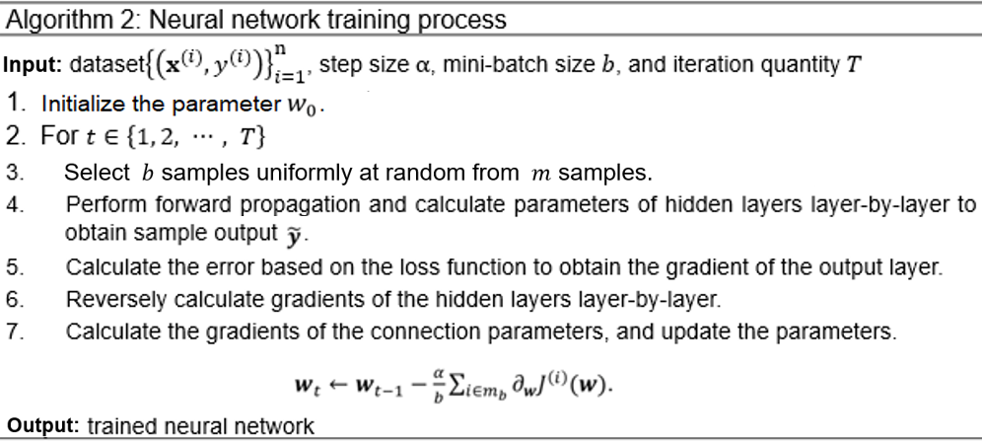
Backward Propagation

Slide 68
Contents
Basic Knowledge
Feedforward Network
Backward Propagation
Generalization Ability
Architecture Design

Slide 69
Generalization Ability
In the overfitting and underfitting sections, the concept of generalization ability is introduced, that is, the adaptability of a machine learning algorithm to fresh samples.
The neural network includes a large number of parameters and has a strong nonlinear transformation ability, so it is easy to cause overfitting of the training set. The accuracy of the model is very high on the training set, and the loss is very low, but the effect is very poor on the testing data; that is, due to lack of generalization ability, the model cannot adapt to the new samples.
It is possible that the model has high accuracy on the training set because the model remembers the actual labels of some samples, instead of learning the features of the data.
The reasons for the lack of the generalization ability include:
Noise in the dataset
Insufficient training data
High model complexity due to over-training of models

Slide 70
Generalization Ability
To improve the generalization ability of the model, many solutions are proposed:
Reducing the complexity of the model by reducing its depth and width
Performing data augmentation on datasets such as image rotation, translation, or zooming
Adding regular noise such as Gaussian noise
Adding the regularization term to control parameter complexity
Using the early stopping method during training
Drop out

Slide 71
Contents
Basic Knowledge
Feedforward Network
Backward Propagation
Generalization Ability
Architecture Design

Slide 72
Architecture Design
A key factor to consider when designing a neural network is its architecture.
Architecture refers to the overall structure of a network: how much capacity it has and how these units are connected.
Most neural networks are organized into a set of units, referred to as layers. In most neural networks, these layers are arranged into a chain structure, with each layer being a function of a previous layer.
In these chain-based architectures, the depth of the network and width of each layer are the main considerations.

Slide 73
Architecture Design
In practical applications, the neural network shows greater diversity, in addition to the depth of the network and the width of each layer.
Many architectures build a main chain, but then add more architectural features to it, such as skipping connections from the first layer to the second layer or higher. These skipped connections make gradient easily flow from the output layer to layers close to the input.

Slide 74
Architecture Design
Another key factor to consider when designing architecture is how to connect a pair of layers together.
In the default neural network framework, each input unit is connected to all output units.
However, in some popular network frameworks, each unit in the input layer is connected to only a small portion of the units in the output layer. These strategies for reducing the number of connections reduce the number of parameters and calculations required for evaluating the network; however, they are often highly dependent on real problems.
In the following sections, we will discuss numerous specific neural network structures developed for specific tasks.
The special computer vision structure is referred to as the convolutional network.
Feedforward networks can also be extended to recursive neural networks for sequence processing.

Slide 75
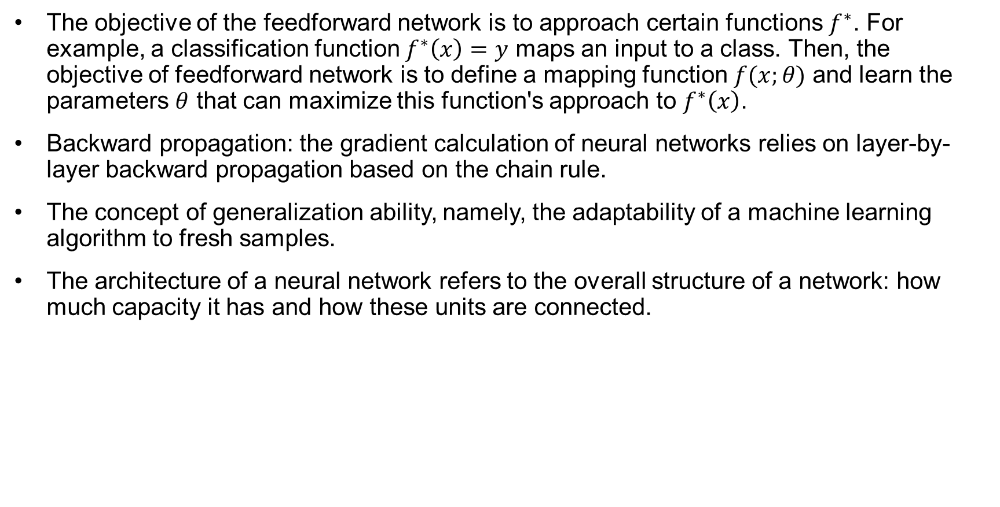
Summary
The objective of the feedforward network is to approach certain functions $f^{∗}$. For example, a classification function $f^{∗}\left(x\right)=y$ maps an input to a class. Then, the objective of feedforward network is to define a mapping function $f(x;θ)$ and learn the parameters $θ$ that can maximize this function's approach to $f^{∗}\left(x\right)$.
Backward propagation: the gradient calculation of neural networks relies on layer-by-layer backward propagation based on the chain rule.
The concept of generalization ability, namely, the adaptability of a machine learning algorithm to fresh samples.
The architecture of a neural network refers to the overall structure of a network: how much capacity it has and how these units are connected.

Slide 76
Training of Deep Learning Models

Slide 77
About This Course
This part intends to explain:
Key challenges for deep learning
Regularization, adaptive learning rate, dropout and batch normalization in deep learning

Slide 78
Contents
Key Challenges for Deep Learning
Loss function and regularization
Adaptive Learning Rate
Dropout
Batch Normalization

Slide 79
Key Challenges: Data Volume
The larger the dataset is, the more likely we are to obtain a powerful deep learning model. To some extent, data volume often determines the effects of deep learning.

Slide 80
Key Challenges: Data Processing Device
Even if researches can obtain large datasets, they often face another challenge: how can they process the data efficiently?
Industrial deep learning systems require large data processing centers.
Mobile intelligent devices require small but efficient computing devices.
Facebook's data center in Oregon

Slide 81
Key Challenges: Overfitting
Typically, researchers train models to deliver maximum performance on training datasets.
However, there are significant differences between training datasets and unknown datasets.
The models memorize the examples on the training datasets, but are unable to fit new cases and examples.

Slide 82
Key Challenges: Hyperparameter Settings
The settings of hyperparameters have a significant impact on a model's performance.
Unlike the parameters in model training, hyperparameters are defined before model learning begins.
The settings or adjustments of hyperparameters often depend on the experience of researchers or the final training results of the model.

Slide 83
Key Challenges: Non-transparency
The training process is not transparent, reducing the interpretability of the deep learning model.
The deep learning model is essentially a black-box algorithm. If the model is given inputs, we are only able to observe outputs.
Without sufficient interpretability, the model does not apply to areas that focus on validation processes.

Slide 84
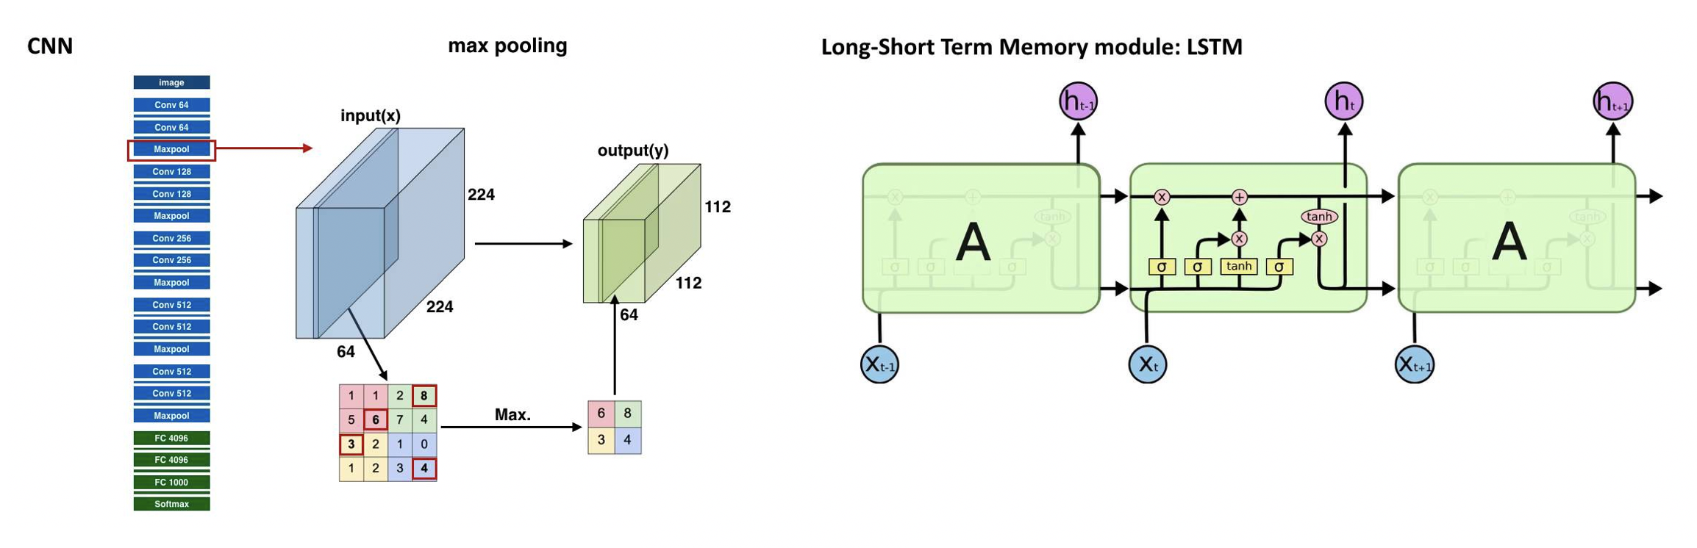
Key Challenges: Flexibility
At present, a well-trained neural network structure can only be used for a specific task in a specific domain.
As the Google DeepMind's research scientist Raia Hadsell summed it up:
There is no neural network in the world, and no method right now that can be trained to identify objects and images, play Space Invaders, and listen to music.

Slide 85
Contents
Key Challenges for Deep Learning
Loss function and regularization
Adaptive Learning Rate
Dropout
Batch Normalization

Slide 86
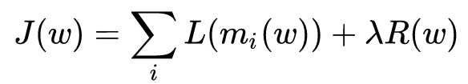
Loss function
Loss function is usually a function defined on a data point, prediction and label, and measures the penalty.
Loss function usually has two parts: loss term and regularization term.

Slide 87
Regularization
Regularization aims to reduce the generalization errors of models by modifying the learning algorithms.
Regularization is a solution to the overfitting and underfitting problems in deep learning.
However, this approach often increases the training errors of models.
In general, the only way to modify learning algorithms is to add or reduce some functions (to affect the characterization capabilities of models).

Slide 88
Regularization: Weight Decay
The linear regression of weight decay is designed to minimize both the mean square error and a weight expression that prefers a smaller L2 norm, that is:
$$\tilde{J}\left(w\right)=\frac{1}{2m}\sum_{i=1}^{m}{{\left(h\left(x^{(i)}\right)−y^{(i)}\right)}^{2}}+λw^{T}w$$
where $λ$ is defined in advance to represent your desire to have a small weight.
When $λ$ is set to 0, the L2 norm of the weight is not considered.
When $λ$ is set to a larger value, the model will force the L2 norm of the weight to be smaller.

Slide 89
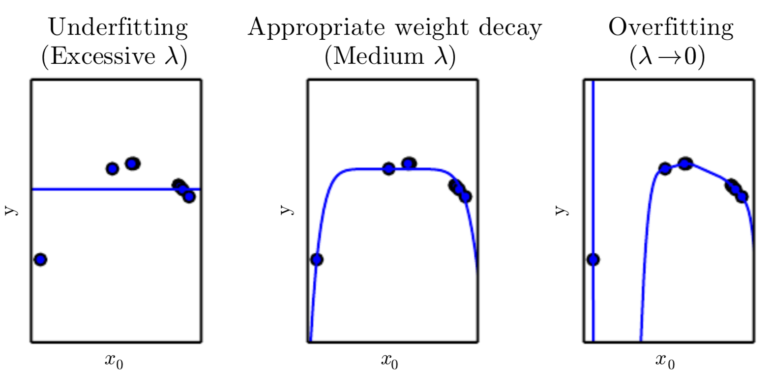
Regularization: Weight Decay
Minimizing $\tilde{J}\left(w\right)$ leads to a tradeoff of weight w between fitting the training data and selecting a smaller L2 norm.
Because a large $λ$ is used in the left figure, the model is forced to learn a constant function with no slope. (Obviously, the constant function can only underfit the model).
The right figure uses a $λ$ close to 0, so that the model allows a larger slope but leads to overfitting.
In the middle figure, the model is fitted closely when a suitable $λ$ is set. Although this model can represent more complex functions than the model shown in the left figure, the small weight decay coefficient forces it to output a simpler function.

Slide 90
Regularization Factors
In weight decay, we express our preference for a linear model defined with a smaller weight, but there are many other ways to express preferences for different models and solutions. The methods used for adjusting models are collectively called regularization.
Typically, researchers regularize a deep learning model by adding a regularization term to the original loss function.
In the preceding weight decay example, the regularization term is $Ω\left(w\right)=w^{T}w.$
There are many methods for regularizing deep learning. The following slides describe some of the important methods.

Slide 91
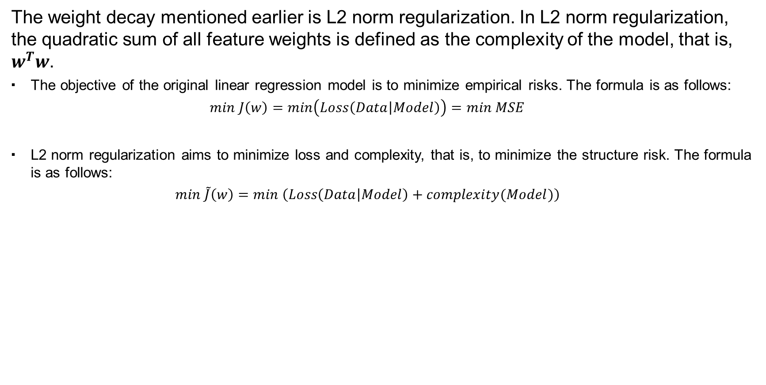
L2 Norm Regularization
The weight decay mentioned earlier is L2 norm regularization. In L2 norm regularization, the quadratic sum of all feature weights is defined as the complexity of the model, that is, $w^{T}w$.
The objective of the original linear regression model is to minimize empirical risks. The formula is as follows:
$$min J\left(w\right)=min\left(Loss\left(Data | Model\right)\right)=min MSE$$
L2 norm regularization aims to minimize loss and complexity, that is, to minimize the structure risk. The formula is as follows:
$$min \tilde{J}\left(w\right)=min \left(Loss\left(Data | Model\right)+complexity(Model)\right)$$

Slide 92
L2 Norm Regularization
To gain a greater understanding, we will examine the gradient of the objective function for L2 norm regularization.
Assume that a model has this regular objective function:
$$\tilde{J}\left(w\right)= \frac{λ}{2}w^{T}w+J(w)$$
The corresponding gradient can be calculated as follows:
$$\frac{∂\tilde{J}\left(w\right)}{∂w}=λw+\frac{∂J\left(w\right)}{∂w}$$
After the stride of $ϵ$ is used and the weights are updated iteratively, the following result is obtained:
$$w←\left(1−ϵλ\right)w−ϵ\frac{∂J\left(w\right)}{∂w}$$

Slide 93

L2 Norm Regularization
This slide also uses the linear regression problem as an example. This is the objective function of linear regression:
$$w^{∗}=\underset{w}{argmin}{\frac{1}{2m}{\left(y−Xw\right)}^{T}\left(y−Xw\right)}$$
This is its solution:
$$w^{∗}={\left(X^{T}X\right)}^{−1}X^{T}y$$
After L2 norm regularization is added to the original objective function, the objective function becomes:
$$w^{∗}=\underset{w}{argmin}{\frac{1}{2m}{\left(y−Xw\right)}^{T}\left(y−Xw\right)}+\frac{λ}{2}w^{T}w$$
And the solution becomes:
$$w^{∗}={\left(X^{T}X+λI\right)}^{−1}X^{T}y$$

Slide 94
L2 Norm Regularization
$$w^{∗}={\left(X^{T}X+λI\right)}^{−1}X^{T}y$$
The matrix $X^{T}X$ in the original solution is replaced by ${\left(X^{T}X+λI\right)}^{−1}$.
As a result, the original matrix is added with a diagonal matrix of $λ$, which represents the variation of each input feature. L2 norm regularization enables the learning algorithm to perceive the input data with a larger variance, which also reduces the weight of the feature compared with the covariance of the output target.

Slide 95
L1 Norm Regularization
Another way to control the complexity of weights is through L1 norm regularization, also known as Lasso regularization. L1 norm regularization adds the absolute value of the weight coefficient as a regularization term to the loss function. Given the weight coefficient w of the model, the L1 regularization term is defined as follows:
Given the weight coefficient $w$ of the model, the L1 regularization term is:
$$Ω\left(w\right)={∥w∥}_{1}= \sum_{i}{w_{i}}$$
where ${∥·∥}_{1}$ indicates the L1 norm. Compared with L2 norm regularization, L1 norm regularization reduces some insignificant feature coefficients to zero during training so that some features disappear completely. This means that L1 norm regularization allows appropriate selection of features for the model when there are a large number of features.

Slide 96
L1 Norm Regularization
Loss function after L1 norm regularization:
$$\tilde{J}\left(w\right)={λ∥w∥}_{1}+J(w)$$
Gradient:
$$\frac{∂\tilde{J}\left(w\right)}{∂w}=λsign(w)+\frac{∂J\left(w\right)}{∂w}$$
We can see that L1 norm regularization has a completely different effect on the gradient compared with L2 norm regularization.
L2 norm regularization makes w affect the gradient of each step linearly. In L1 norm regularization, the effect of w on the gradient becomes a constant factor, and its symbol is consistent with that of w.

Slide 97
Contents
Key Challenges for Deep Learning
Loss function and regularization
Adaptive Learning Rate
Dropout
Batch Normalization

Slide 98
Adaptive Learning Rate
Following an introduction to the methods for improving the performance of deep learning models, this section focuses on how to optimize the training process of deep learning systems.
The learning rate in the training process is problematic for both the basic gradient descent algorithm and other optimization algorithms described in earlier courses.
The invariable learning rate affects a model's convergence speed, while the training time increases and the computational overhead remains high.

Slide 99
Adaptive Learning Rate
If, however, we use a variable learning rate, we can significantly improve the convergence speed. In this section, we describe three commonly used adaptive learning rate algorithms:
AdaGrad
RMSProp
Adam
We start by reviewing the gradient descent formula:
$$w_{t}=w_{t−1}−α∇J\left(w_{t−1}\right)$$
where $α$ is the learning rate; $∇J\left(w_{t−1}\right)$ is the direction.

Slide 100
Adaptive Learning Rate: AdaGrad
Each parameter has a different updating direction and amplitude when the gradient descent algorithm is applied. At a given time, some variables may approximate their minimum values, but others may remain close to their initial positions. At this time, problems may occur when the learning rate remains unchanged.
If the learning rate is high, the parameters close to their minimum values may become unstable.
If the learning rate is low, the convergence is slow even when a small number of parameters are updated.
AdaGrad sets different learning rates for different parameters.
The learning rate is first set to a large value to decrease the gradient quickly.
Then it is reduced for the parameters that have fallen considerably.

Slide 101
Adaptive Learning Rate: AdaGrad
AdaGrad calculates the gradient and then accumulates the square of the gradient.
$$g_{t}=∇J\left(w_{t−1}\right)$$
$$r←r+g_{t}⨀g_{t}$$
Based on the cumulative square of the gradient, updates are calculated as follows:
$$w_{t}←w_{t−1}−\frac{ε}{δ+\sqrt{r}}⨀g_{t}$$
where$δ$ is a minimum value used to prevent the denominator from being 0;$ε$ is a global learning rate.

Slide 102

Adaptive Learning Rate: AdaGrad
Advantages and disadvantages of AdaGrad:
As the training process continues, the cumulative gradient becomes larger and larger, thereby lowering the overall learning rate. AdaGrad can automatically change learning rates through iterations.
AdaGrad has one significant disadvantage: The cumulative sum of its denominators is always increasing. Due to this disadvantage, the learning rate is reduced and becomes infinitely low, preventing the algorithm from updating weights.

Slide 103
Adaptive Learning Rate: RMSProp
With AdaGrad, the main problem is that the learning rate will be infinitely low. RMSProp, as an extension to AdaGrad, solves this problem by finding the logarithmic mean value of the square gradient in the current state.
The formula for defining the mean square gradient of time t is as follows:
$$r_{t}=γr_{t−1}+(1−γ)g_{t}⨀g_{t}$$
where $r_{t}$ is the mean square gradient at time t-1;$γ$ is the proportionality coefficient of the logarithmic mean. The corresponding gradient update is:
$$w_{t}←w_{t−1}−\frac{ε}{\sqrt{δ+r_{t}}}⨀g_{t}$$
where the settings of $δ$ and$ε$ are the same as those in AdaGrad.

Slide 104

Adaptive Learning Rate: RMSProp
Where RMSProp differs from AdaGrad is that averaging, rather than summing, is performed to effectively avoid an infinitely low learning rate.
AdaGrad
$r←r+g_{t}⨀g_{t}$
RMSProp
$r_{t}=γr_{t−1}+(1−γ)g_{t}⨀g_{t}$

Slide 105
Adaptive Learning Rate: Adam
Adam is also a commonly used adaptive learning rate algorithm, and can be considered as an optimization of RMSProp. Unlike RMSProp, Adam has less deviation in the early stages of model training.
Adam calculates the first-order gradient deviation according to the following formula:
$$s_{t}=γ_{1}s_{t−1}+(1−γ_{1})g_{t}$$
where $g_{t}$ is the gradient at time t;$γ_{1}$ is the first-order gradient cumulative coefficient. Similar to RMSProp, Adam then calculates the square gradient cumulative coefficient according to the following formula:
$$r_{t}=γ_{2}r_{t−1}+(1−γ_{2})g_{t}⨀g_{t}$$
where $γ_{2}$ is the square gradient cumulative coefficient.

Slide 106

Adaptive Learning Rate: Adam
After $s_{t}$ $and r_{t}$ are determined, Adam calculates the first- and second-order corrections:
$$\tilde{s_{t}}←\frac{s_{t}}{1−γ_{1}}$$
$$\tilde{r_{t}}←\frac{r_{t}}{1−γ_{2}}$$
Based on the first- and second-order corrections, Adam updates weight:
$$w_{t}←w_{t−1}−ε\frac{\tilde{s_{t}}}{δ+\sqrt{\tilde{r_{t}}}}$$

Slide 107
Contents
Key Challenges for Deep Learning
Loss function and regularization
Adaptive Learning Rate
Dropout
Batch Normalization

Slide 108
Dropout
Although the regularization approaches described in the previous section can alleviate overfitting to some extent, another method to achieve this is called dropout. Dropout can be used not only to alleviate overfitting of deep learning systems, but also to shorten the time needed for network training.
The functioning of some detectors in the training of deep learning models relies on other detectors — this is called interaction between detectors. To prevent overfitting, dropout proposes to improve the performance of neural networks by blocking the interaction between feature detectors. In each training batch, dropout aims to reduce the interaction between hidden-layer nodes, and thereby alleviate the overfitting problem, by ignoring half of these nodes in the network.

Slide 109

Dropout
Dropout allows certain neuronal activation values to stop working at a certain probability when the standard neural network performs forward propagation. By doing so, the dependence of the models on local features can be reduced, and the generalization ability of the models can be improved. This therefore alleviates the overfitting problem.
Standard neural network
Neural network using dropout

Slide 110
Dropout
In the standard neural network, after the given input$x$ is propagated in the forward direction on the network, the error is propagated in the reverse direction. This is performed to determine how best to update the parameters for optimal learning, resulting in the output $y$. In the network using dropout, the process is listed as follows:
Delete half of the hidden-layer neurons in the network at random, but do not change the input or output neuron. In the right figure of the previous slide, the dashed circles represent the deleted neurons in this training batch.
Propagate the input $x$ in the forward direction through the neural network modified in step 1, and then propagate the loss result in the reverse direction. After a batch of training samples is completed, the corresponding parameters are updated on the remaining neurons by using the stochastic gradient descent method.
Restore the deleted neurons. Note that the deleted neurons remain unchanged, but the neurons that were not deleted are updated in the previous batch.
Execute the next batch of training samples and repeat the preceding steps.

Slide 111
Dropout
The standard neural network uses the following calculation formula:
$$y_{i}^{l+1}=f\left(z_{i}^{l+1}\right)=f(w_{i}^{l+1}y^{l}+b_{i}^{l+1})$$
In the network using dropout, some hidden-layer neurons are randomly closed before each training batch. If we assume that the probability of each neuron being closed is $p$ , we can use Bernoulli distribution to express the probability of closing the $jth$neuron at layer $l$ as follows:
$$r_{j}^{l}\sim Bernouli(p)$$
If $r_{j}^{l}$ is 0, the $jth$neuron at layer $l$ is closed; if $r_{j}^{l}$ is 1, the $jth$neuron at layer $l$ is opened. The forward process can be expressed by:
$${\tilde{y}}^{l}=r^{l}∗y^{l}$$
$$y_{i}^{l+1}=f\left(z_{i}^{l+1}\right)=f(w_{i}^{l+1}{\tilde{y}}^{l}+b_{i}^{l+1})$$

Slide 112
Dropout: Advantages
In practical applications, dropout is more effective than other regularization approaches.
The test results of a model using dropout on the validation dataset are often better than those when using other regularization approaches. With large datasets, dropout can significantly improve the generalization ability of the model.
Dropout has a very low computational overhead, meaning that only the time complexity of $O(n)$ in each training batch is increased.
Unlike many regularization approaches that have clear limitations on applicable models, dropout can be used in a variety of neural network models, such as feedforward, convolutional, and recurrent neural networks.

Slide 113
Dropout: Analysis
Why can we improve the final performance of the model by randomly closing part of hidden-layer neurons in each training batch?
Similar to what we can do with ensemble learning, we can use the same training dataset to train multiple different neural networks. Through this, we can obtain different results, and then average these results — this method can usually prevent overfitting.
In each step, dropout randomly closes part of the hidden-layer neurons, meaning that the entire dropout process is equivalent to averaging on many different neural networks.
Averaging offsets different overfitting on different networks.
In addition, dropout reduces the complex co-adaptation relationship between neurons. Because two neurons may not be opened every time when dropout is used, the update of weights no longer relies on the co-action of hidden-layer nodes with fixed relationships. This forces the network to learn more robust features rather than only a few local ones.

Slide 114
Contents
Key Challenges for Deep Learning
Loss function and regularization
Adaptive Learning Rate
Dropout
Batch Normalization

Slide 115
Batch Normalization: Internal Covariate Shift
In deep learning, adjusting the training parameters of the deep neural network is extremely difficult. As mentioned earlier, to help the model achieve faster convergence during training, it is often necessary to try different regularization approaches and learning rates.
One of the main reasons for the difficulty in training the deep neural network is the strong correlations between layers of the neural network. These correlations lead to internal covariate shift.

Slide 116
Batch Normalization: Internal Covariate Shift
Internal covariate shift means that slight changes in the underlying network parameters are magnified with the deepening of network layers, because of the linear transformation and nonlinear mapping at each layer.
When the parameters of a layer change, so does the distribution of inputs to subsequent layers. The network has to continuously re-adapt to these shifts in input distributions, making it extremely difficult to train models.
In other words, parameter changes in the network will shift the distribution of internal node data during the deep network training process. Internal covariate shift will bring two problems to deep network training:
Continuous re-adaptation to shifts in input distributions leads to a lower learning rate.
The training process may easily fall into the gradient saturated region, slowing down the convergence of the network.

Slide 117
Batch Normalization
To overcome internal covariate shift, batch normalization provides a method that simplifies calculation while also ensuring the original expression ability of data.
Because the input of full-batch training data requires a large amount of memory and each round of training is excessively long, mini-batch training is usually used in a deep learning system. Batch normalization is a method based on mini-batches.
Here we will start by reviewing the feedforward formulas of layer$l+1$ of the neural network:
$$z_{i}^{l+1}=w_{i}^{l+1}y^{l}+b_{i}^{l+1}$$
$$y_{i}^{l+1}=f(z_{i}^{l+1})$$
where$y^{l}$ is the output of layer $l$.

Slide 118
Batch Normalization
For all neural nodes at layer $l+1$, the mean value and variance are calculated during batch normalization according to the following formulas:
$$μ=\frac{1}{m}\sum_{i=1}^{m}{z_{i}^{l+1}}$$
$$σ^{2}=\sum_{i=1}^{m}{{(z_{i}^{l+1}−μ)}^{2}}$$
After the mean value and variance are calculated, the output of layer $l+1$ is normalized:
$${\tilde{z}}^{l+1}=γ\frac{z^{l+1}−μ}{\sqrt{σ^{2}+ε}}+β$$
$$y_{i}^{l+1}=f({\tilde{z}}^{l+1})$$

Slide 119
Batch Normalization: Analysis
In practice, batch normalization has been proven able to facilitate neural network training.
Batch normalization ensures that the mean value and variance of inputs at each layer of the network are within a certain range. This means that the next layer does not need to continuously re-adapt to changes in the output of the previous layer. The distribution of inputs at each layer is relatively stable, facilitating a faster learning rate of the model.
Batch normalization can reduce the model's sensitivity to the parameters in the network and simplify the process of parameter adjustment. In addition, batch normalization allows the network to use saturated activation functions such as sigmoid and tanh. Any changes in the underlying network can easily accumulate in the upper-layer network, causing the model to enter the gradient saturated region of activation functions and, subsequently, causing the gradient to disappear. These saturated activation functions can alleviate gradient disappearance.
Batch normalization can produce some regularization effects in practical applications. As the mean values and variances of different mini-batches are used as an estimate of all training samples, additional random noise is caused in the learning process, which is similar to the random closure of neurons in dropout.

Slide 120
Summary
Regularization aims to reduce the generalization errors of models by modifying the learning algorithms.
Regularization is a solution to the overfitting and underfitting problems in deep learning.
However, this approach often increases the training errors of models.
Dropout allows certain neuronal activation values to stop working at a certain probability when the standard neural network performs forward propagation. By doing so, the dependence of the models on local features can be reduced, and the generalization ability of the models can be improved. This therefore alleviates the overfitting problem.
Adaptive learning rate refers to using a variable learning rate during training to significantly improve the convergence speed.
Three common adaptive learning rate algorithms:
AdaGrad
RMSProp
Adam
Batch normalization is a solution to internal covariate shift. It simplifies calculation while also ensuring the original expression ability of data.

Slide 121
Practical exercise 2
Ada_grad.ipynb

Slide 122
About This Course
Timetable for this afternoon
2:00 – 3:30
Introduction to classic deep learning task scenarios
Prepare your data set: what is labeled data, how to obtain the data set, Data format preparation (ready-made data format and data format conversion of custom labeling tasks) , MindSpore's support for different data formats
What is an AI computing framework
3:45 – 5:15
Develop MindSpore based on the ModelArts platform
Practical exercises: implement a feedforward neural network based on MindSpore, and show the training process and prediction results
Practical exercises: On-cloud training and on-device inference scenario demonstration under the framework of device-cloud collaboration
If you have other questions, please ask in our Wechat/Whatsapp group.

Slide 123
Thank you!

